Slide 1
Boundary Operating Procedures
3D Elevation Program

Slide 2
Shapefile Requirements by Project Type
*Must be completed and uploaded to PTS before operations receives the data
One
Coordinate Reference System
Multiple
Coordinate Reference Systems
Multiple Quality Levels

Slide 3
One Coordinate Reference System *Example naming convention in yellow text
One authoritative project boundary (DPA)
ST_ProjectName_YEAR_B21_DPA_PTS
Uploaded to PTS as a single feature
Same CRS as data
Master tile index (MTI) (covers entire project)
ST_ProjectName_YEAR_B21_MTI
Clipped to DPA extent
Same CRS as data
Attributed with quality level

Slide 4
Multiple Coordinate Reference Systems
One authoritative project boundary (DPA)
ST_ProjectName_YEAR_B21_DPA_PTS
A single feature
In the CRS of the majority of the project
Exception: Projects with Wisconsin county CRS's, DPA will use NAD 83 HARN Wisconsin Transverse Mercator (EPSG 3071)
EPSG Areas (EA)
ST_ProjectName_YEAR_B21_EPSG_EA
One boundary per coordinate reference system
Including minimum 100-pixel overlap
EPSG Indices (EI)
ST_ProjectName_YEAR_B21_EPSG_EI
Sub tile indices per coordinate reference system, clipped to EA
Attributed with quality level

Slide 5
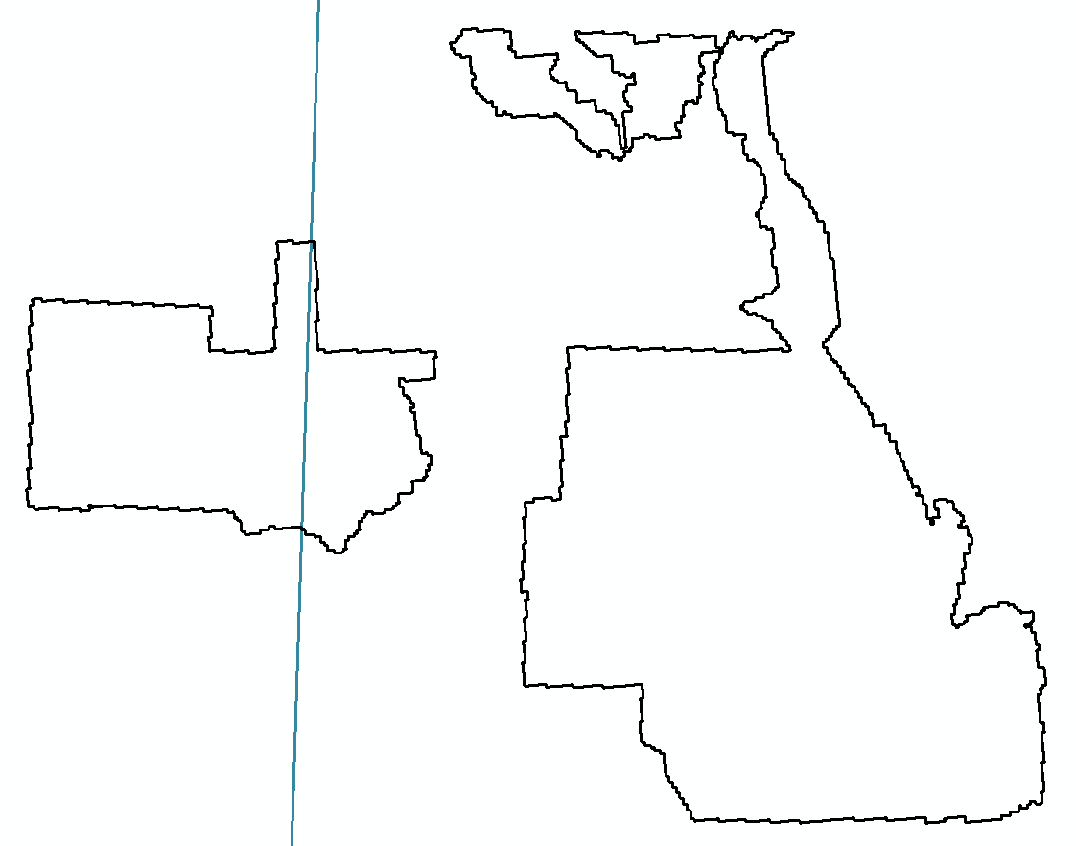
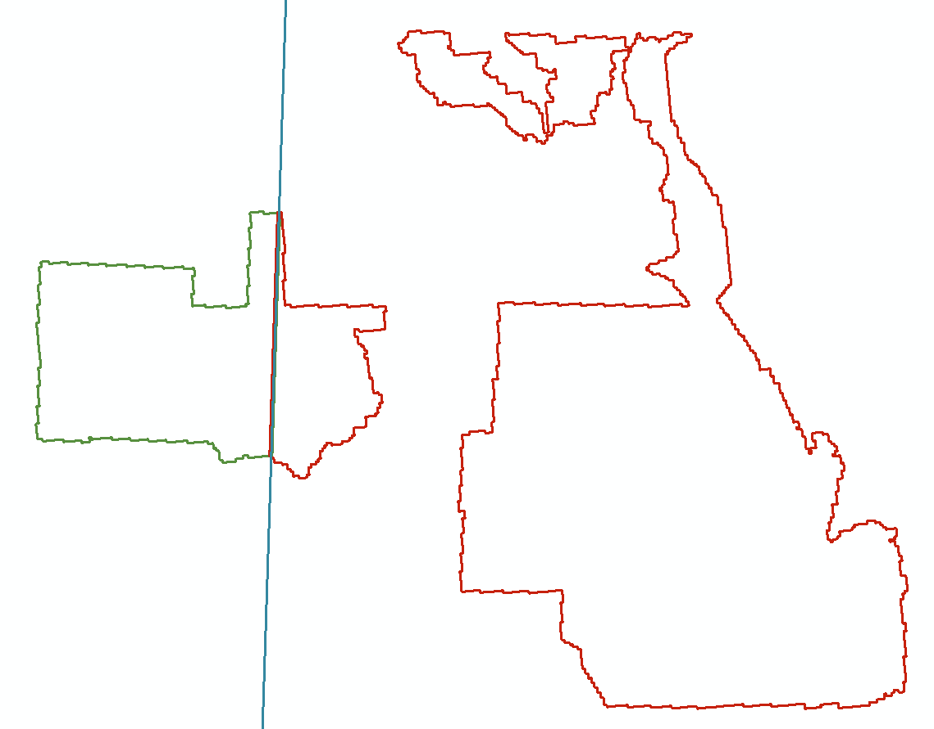
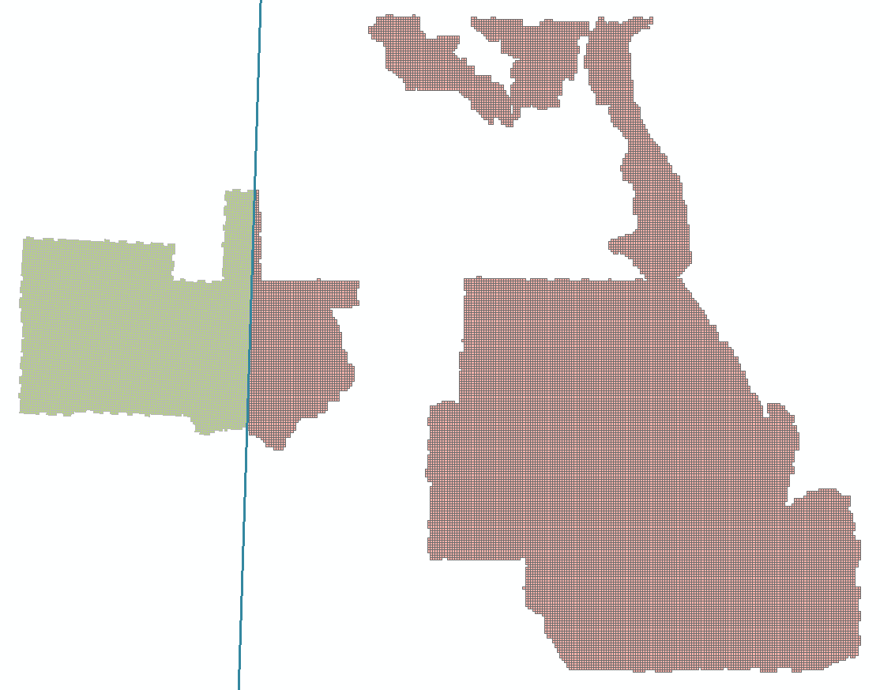
Required Boundaries with Multiple CRS
UTM Zone 12
UTM Zone Boundary
UTM Zone 13
Defined Project Area (DPA)
Single authoritative boundary representing data extent for a work package in the CRS of the majority of the project.
EPSG Area (EA)
A boundary encompassing each CRS in a project, to include a minimum 100-pixel buffer across zone boundary.
EPSG Index (EI)
A tile index per CRS that is buffered and clipped across CRS boundary. A dissolve of the EPSG Index should equal the EPSG Area.

Slide 6
Multiple Quality Levels
One authoritative project boundary (DPA)
ST_ProjectName_YEAR_B21_DPA_PTS
A single feature
Same CRS as data
Master Tile Index (MTI) (QL tiles are same size)
ST_ProjectName_YEAR_B21_MTI
Attributed with quality level
Clipped to DPA extent
Same CRS as data
Project SUB-Tile Indices (QL tiles are different sizes)
ST_ProjectName_YEAR_B21_QL1_TI
Separate tile indices per quality level, attributed with QL information
Clipped to QL extent
Same CRS as data
Minimum 100-pixel overlap is required between quality levels (updated 2/22/22)

Slide 7
Example Scenarios:
1 EPSG, 1QL:
AL_17County_2020_B20_DPA_PTS
AL_17County_2020_B20_MTI
1 EPSG, 2QLs with same size tiles:
AL_17County_2020_B20_DPA_PTS
AL_17County_2020_B20_MTI
1 EPSG, 2QLs with different size tiles:
AL_17County_2020_B20_DPA_PTS
AL_17County_2020_B20_QL1_TI (clipped to QL1 data extent)
AL_17County_2020_B20_QL2_TI (clipped to QL2 data extent)
Ancillary Shapefiles allowed in PTS:
Tribal Lands Boundaries
Tribal Lands Boundaries
AL_17County_2020_B20_TL_AOI

Slide 8
Example Scenarios:
2 EPSG, 1QL:
AL_17County_2020_B20_DPA_PTS
AL_17County_2020_B20_6355_EA
AL_17County_2020_B20_6356_EA
AL_17County_2020_B20_6355_EI (clipped to 6355_EA)
AL_17County_2020_B20_6356_EI (clipped to 6356_EA)
2 EPSG, 2QLs with same size tiles:
AL_17County_2020_B20_DPA_PTS
AL_17County_2020_B20_6355_EA
AL_17County_2020_B20_6356_EA
AL_17County_2020_B20_6355_EI (clipped to 6355_EA)
AL_17County_2020_B20_6356_EI (clipped to 6356_EA)
Ancillary Shapefiles allowed in PTS:
Tribal Lands Boundaries
Tribal Lands Boundaries
AL_17County_2020_B20_6355_QL_AOI
AL_17County_2020_B20_6356_QL_AOI

Slide 9
Example Scenarios:
2 EPSG, 2QLs with different size tiles:
*QL2 is across 2 EAs and QL1 is within a single EA
AL_17County_2020_B20_DPA_PTS
AL_17County_2020_B20_6355_EA
AL_17County_2020_B20_6356_EA
AL_17County_2020_B20_6355_QL1_TI
Clipped to QL1 extent
AL_17County_2020_B20_6355_QL2_TI
Clipped to QL2/6355 extent
AL_17County_2020_B20_6356_QL2_TI
Clipped to QL2/6356 extent
Ancillary Shapefiles allowed in PTS:
Tribal Lands Boundaries
AL_17County_2020_B20_6355_QL_AOI
AL_17County_2020_B20_6356_QL_AOI

Slide 10
Overlap Across EPSG Areas and Quality Level
A minimum 100-pixel buffer is required.

Slide 11
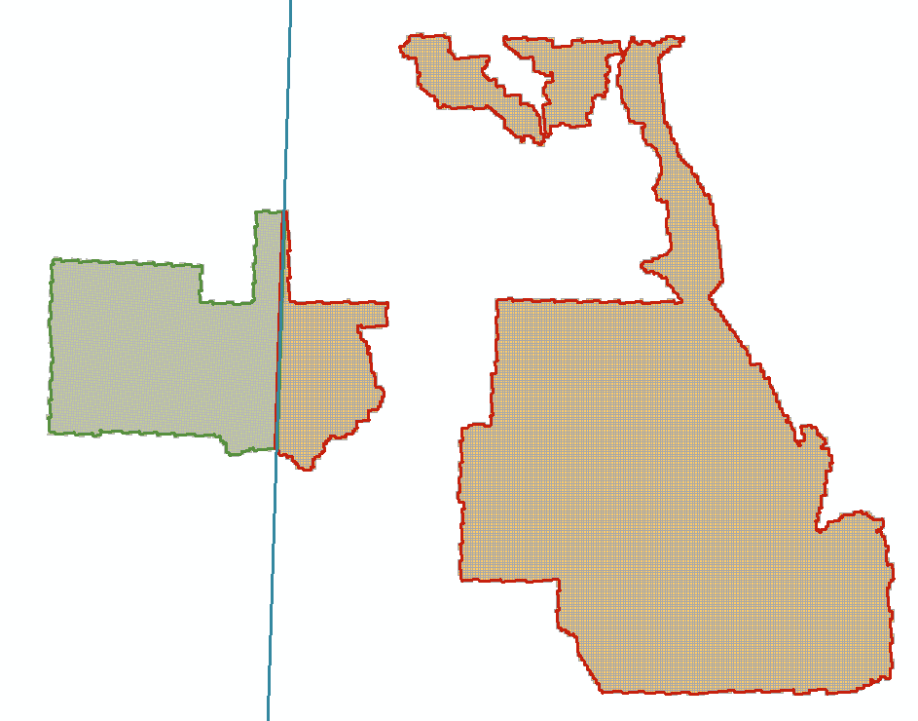
Example: Overlapping Tile Indices Across a UTM Zone Boundary
UTM Zone 12
UTM Zone 13
Some overlap is needed across zone boundaries and between differing quality levels to facilitate raster processing of DEMs. A minimum 100-pixel buffer beyond each zone/QL boundary is required. For example, if DEM ground sample distance is 0.50-meter, buffer shall be ≥ 50 meters. Tiles in each zone shall be clipped back to the corresponding buffered zone boundary.

Slide 12
Buffering a Zone Boundary and Clipping Tile Index
100-pixel buffer on UTM Zone 13
UTM Zone 13 Tiles Clipped Back to 100-Pixel Buffer
UTM Zone 13
UTM Zone 13
100-pixel Buffer
Clipped Back to Buffer

Slide 13
Buffering a Zone Boundary and Clipping Tile Index
100-pixel buffer on UTM Zone 12
UTM Zone 12 Tiles Clipped Back to 100-Pixel Buffer
UTM Zone 12
UTM Zone 12
UTM Zone 13
100-pixel Buffer
Clipped Back to Buffer

Slide 14
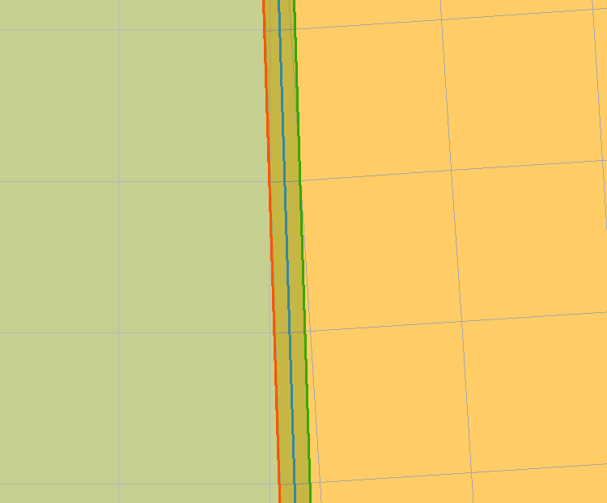
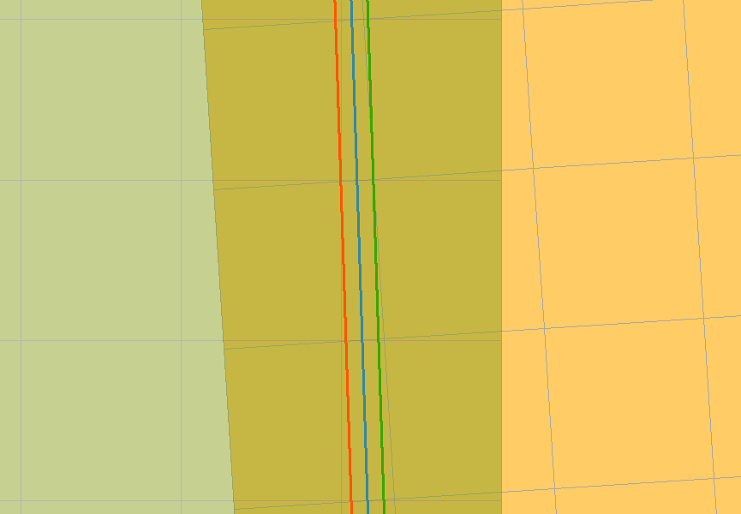
Uniform 100-Pixel Overlap
After Buffer and Clip
UTM Zone 12
UTM Zone 13
Graphic showing the result of buffering across a zone boundary in order to create uniform overlap. Same procedure would apply for boundaries that have different quality level. (updated 2/22/22)
Before Buffer and Clip

Slide 15
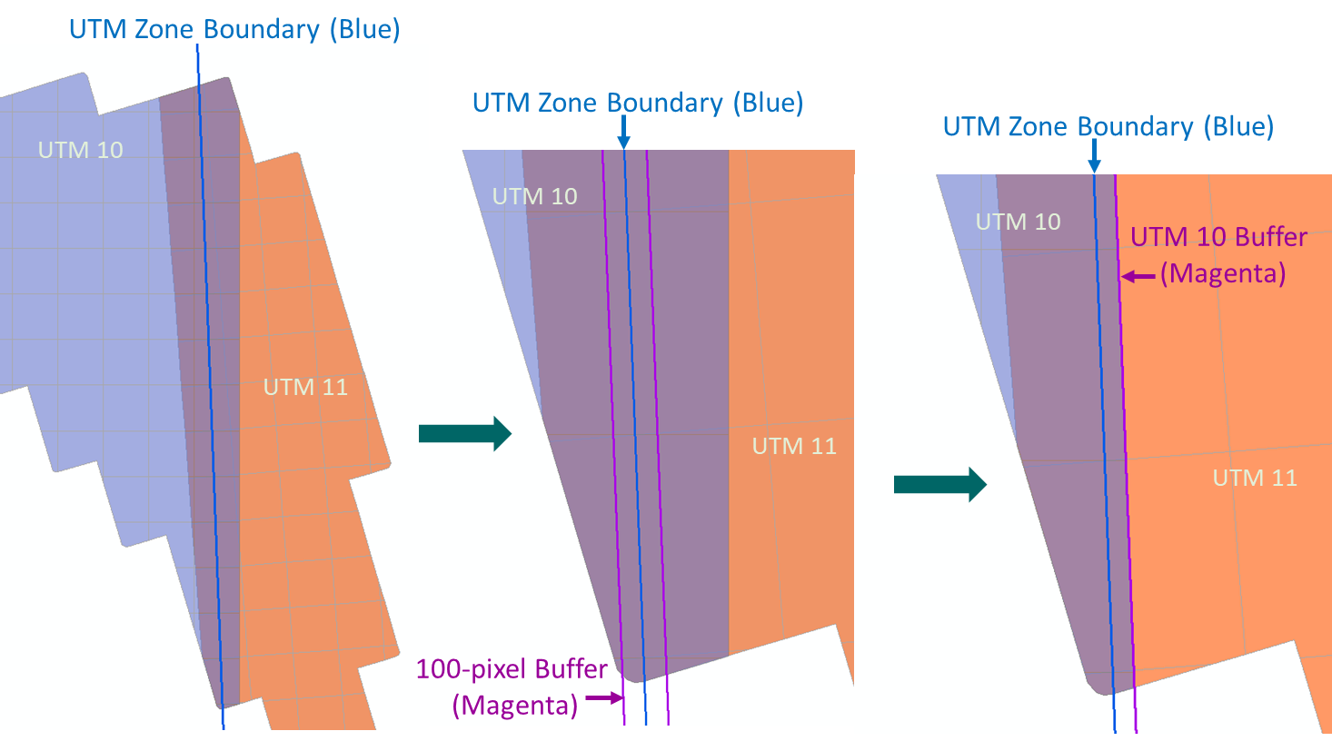
Suggested Buffering Procedure
USGS 3DEP Operations Recommends:
First, apply buffer to the CRS boundary/Quality Level.
Second, clip EPSG Index/EPSG Area/QL Index back to buffered extent. (Alternatively, if using ArcMap, do an intersect with index and buffered CRS zone)
Ensure the associated EPSG Areas (EA’s) are buffered to the same extent as the EPSG Index (EI).

Slide 16
Overlap Procedure to Avoid
USGS 3DEP Operations Recommends:
Avoid using rounded buffered polygons to create overlap as this could cause issues in coverage at their narrowest point (circled in red).

Slide 17
FOR CURRENT TASK ORDERS WHEN CONTACTED BY DATA VALIDATION DUE TO INCONSISTENTCOVERAGE AND/ORBOUNDARIES
Follow the instructions provided in the email by data validation and then proceed to next steps.
When there is a boundary change for a work package the Technical Point of Contact will load the updated boundary into PTS (replacing the old boundary) and will email Michelle Funk, Allyson Jason, and Diana Thunen notifying them of the change. The boundary MUST be in the majority CRS of the dataset. **Keep and archive removed boundary for your records. PTS 3.0 will have a place for old boundaries to be archived, until then you will need to archive them in your own file system.
If the boundary change occurs before any deliveries (including the pilot) to NGTOC, there is no need to notify Operations. If the boundary change occurs after any deliveries, including the pilot, have been received by NGTOC, Milena Janiec, Ryan O’Leary, and Sarah Klaas must be notified by the Technical Point of Contact along with Michelle.
Michelle will use the new boundary loaded into PTS after receiving the email to confirm tribal coverage is up to date.
Tribal Lands
Remember to notify Michelle Funk when a boundry changes that could affect tribal lands

Slide 18
Requested Form Email sent out Aug 24, 2020 – for proposed data deliveries
subject: PROPOSED DATA DELIVERY TILE INDEX
Attached are the tile indexes for the proposed data delivery on [date] for [work package name] , work package ID: [000000].
this delivery consists of one [two/three] spatial reference system(s):
spatial reference system #1
spatial reference system #2
this delivery consists of one [two] quality level(s)
I reviewed the authoritative boundary and tile index in PTS and they correspond with spatial reference system(s) and quality level(s) listed above.
(If applicable) Additional information:
These data are restricted.
These data are collected with supplemental funding.
Please send back the Work Unit ID(s) and associated tile index (indices).

