Slide 1
GPSC Technical Exchange
Josh Nimetz
USGS| National Geospatial Technical Operations Center
Virtual Web Conference
March 14, 2023

Slide 2
Topics for discussion
Numerous pending LBS revisions
Lidar Base Specification Revision Status | U.S. Geological Survey (usgs.gov)
Vector Tile Structure and DEM creation
ASPRS Positional Accuracy Standards update
VVA check points
Check point accuracy
Access to TEM materials – slides, recordings, etc.
https://rockyweb.usgs.gov/outgoing/3DEP_TEM/
GPSCTechnicalInquiries@usgs.gov

Slide 3
Vector Tile Structure and DEM Creation
Please follow latest pending LBS update
https://www.usgs.gov/ngp-standards-and-specifications/tile-scheme-generation-and-crs
In addition, please be mindful of orthogonal tile geometry so rasters are created properly
Imprecise tile coordinates lead to offset pixels within interior of raster data set
Stair-stepped pixels along tile edges clipped to irregular (non-orthogonal) boundaries are okay and expected
Please interpolate your DEMs beyond irregular boundaries and clip back!
Interior vector tile example, sub-pixel gaps were identifiable in interior of data set
!
GPSCTechnicalInquiries@usgs.gov

Slide 4
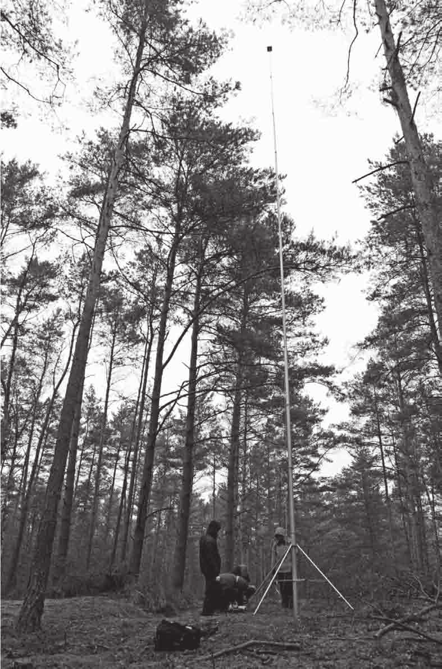
ASPRS Positional Accuracy Standards Update
Review/Comment period extend through April 30, 2023
Please review and comment!
https://docs.google.com/forms/d/e/1FAIpQLSfvq-jNTQDb9gvizr1H9BVOa_kFNLT1AaglJSrP4pUkK8uPpw/viewform
Current Topics Being Deliberated Within USGS and ASPRS
VVA check point quantity and surveying methodology
Check point accuracy
GPSCTechnicalInquiries@usgs.gov

Slide 5
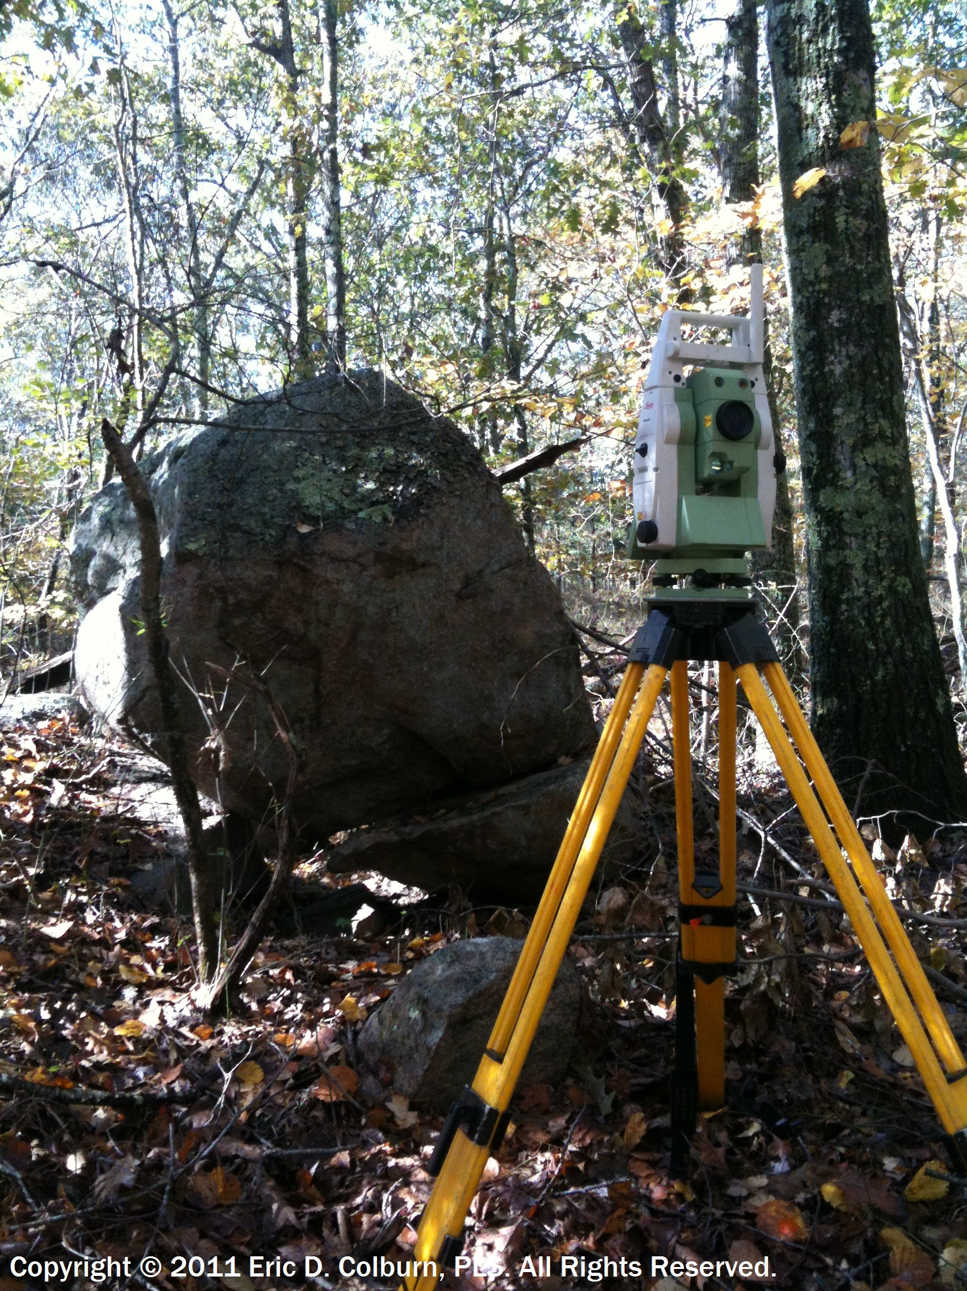
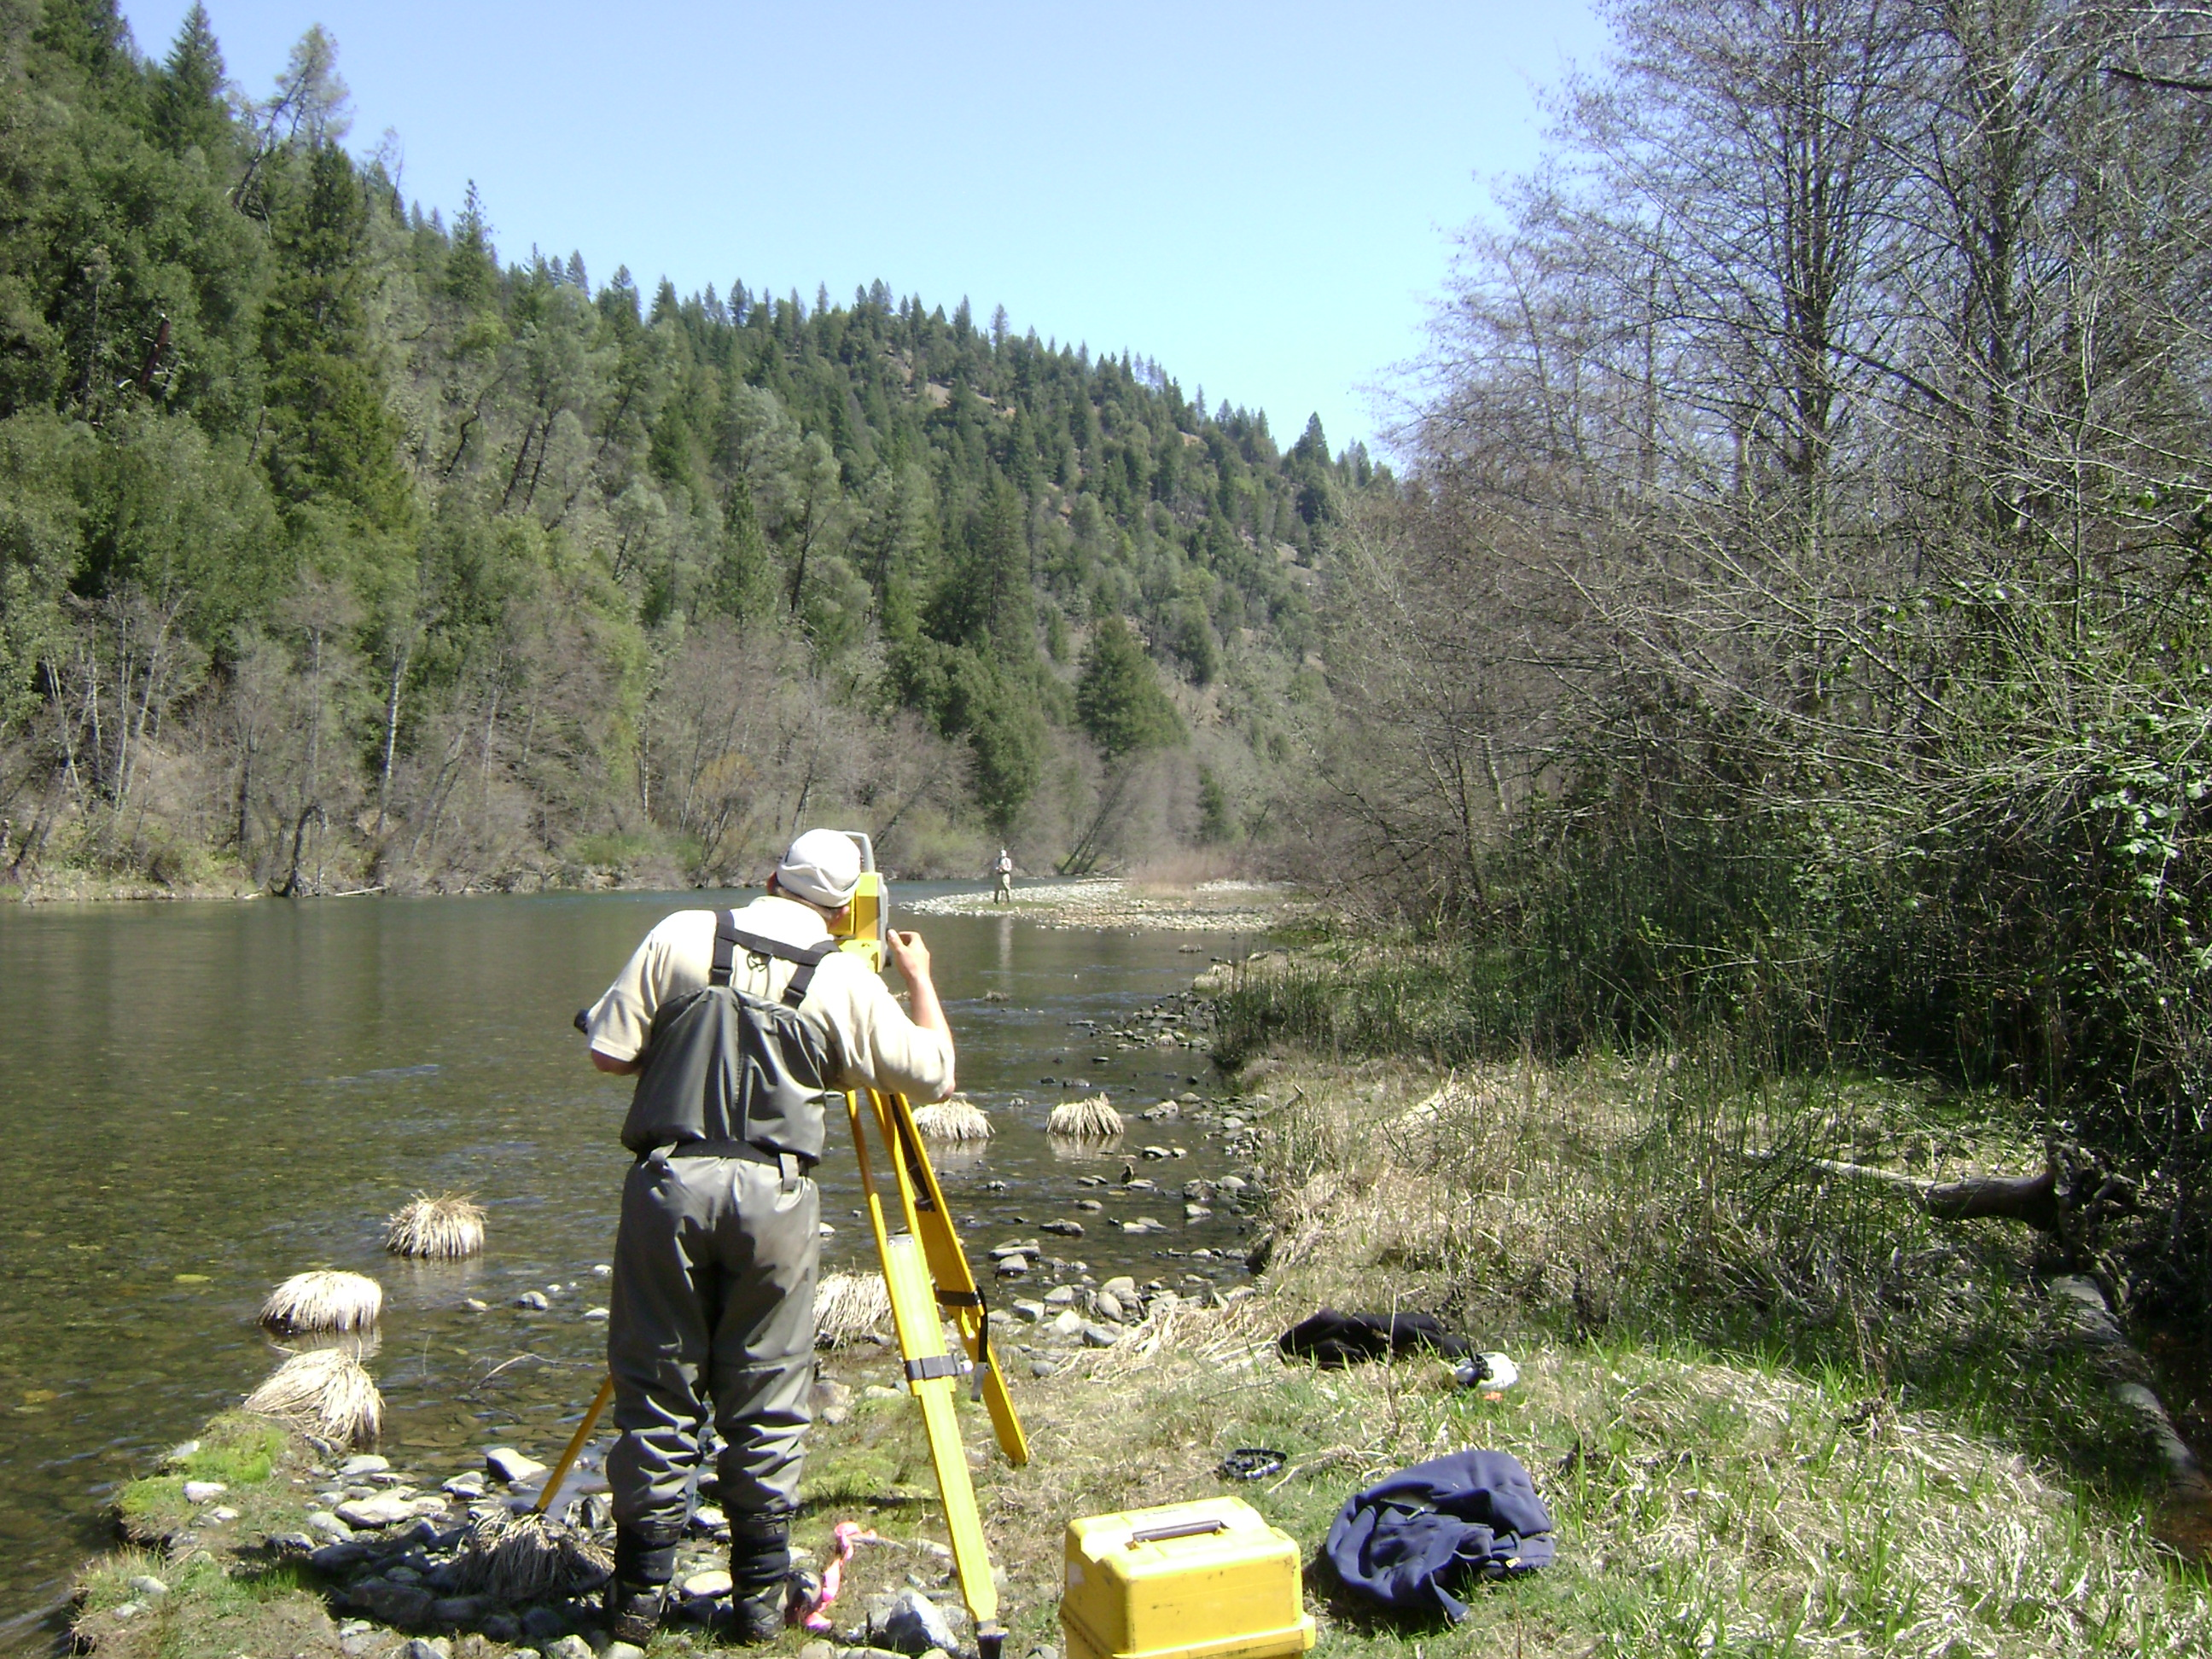
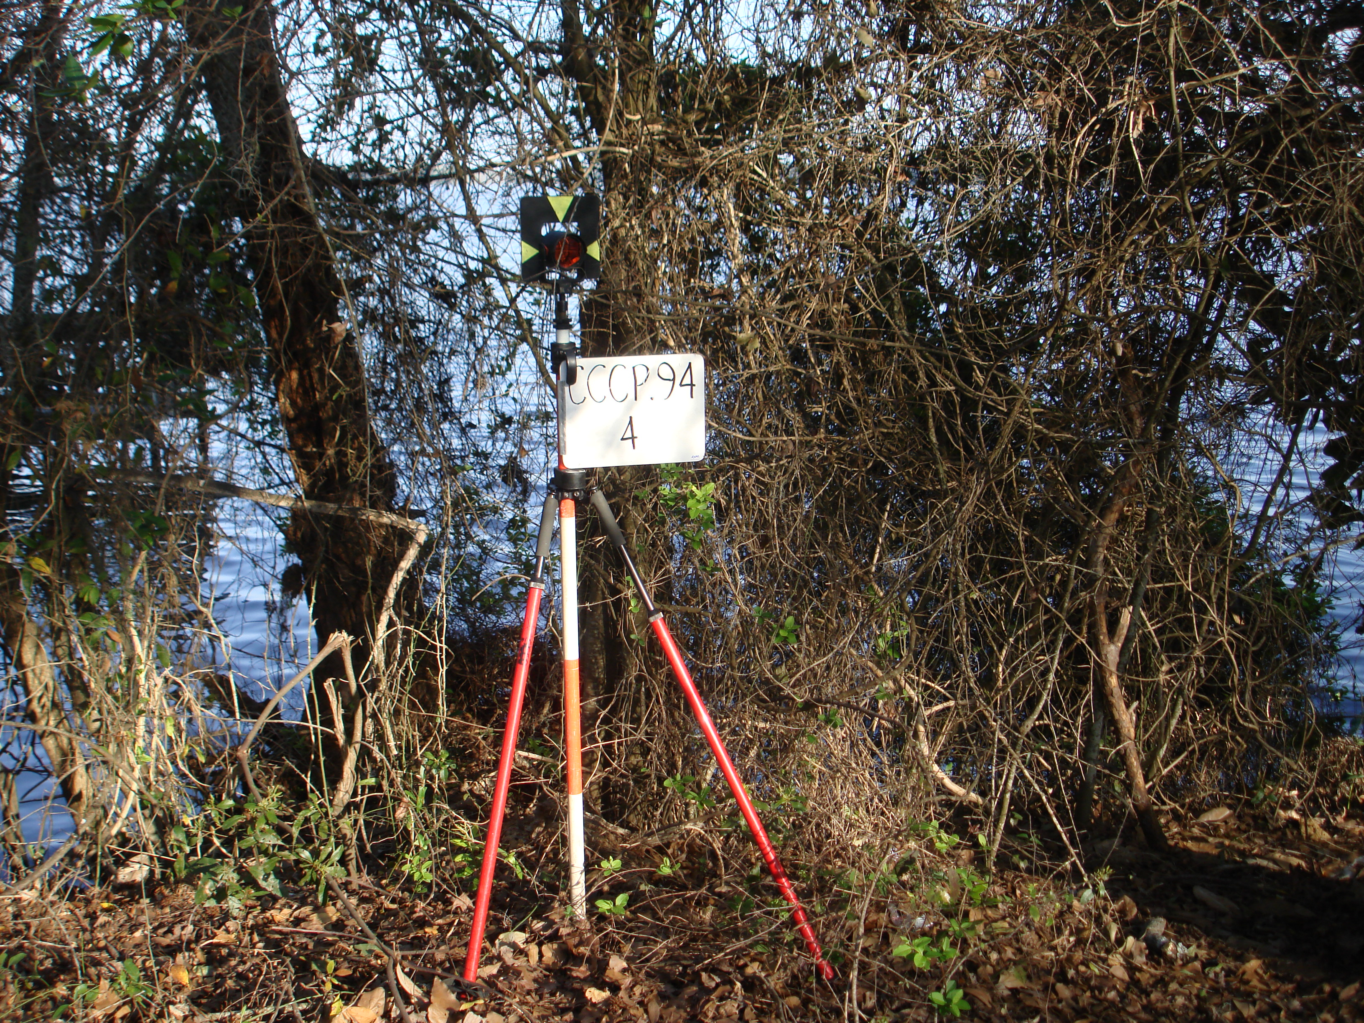
ASPRS Positional Accuracy Standards Update
VVA Check Point Quantity and Surveying Methodology
Removal of pass/fail threshold for VVA assessment
Proposed change calls for equivalent number of NVA and VVA check points with a lower limit/minimum of 30 check points
Do we need more VVA points?
Do we need VVA points?
Survey addendum calls for use of classical surveying with a properly calibrated total station in GPS/GNSS obscured environment
GPSCTechnicalInquiries@usgs.gov

Slide 6
ASPRS Positional Accuracy Standards Update
Check Point Accuracy
Check points have error and the objective is to include this error in overall product accuracy assessment

Slide 7
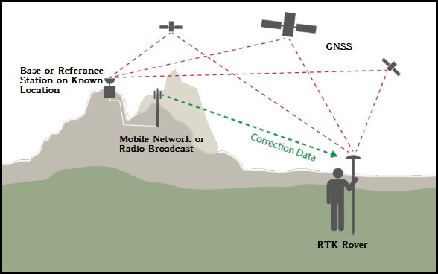
ASPRS Positional Accuracy Standards Update
Check Point Accuracy
Check points (and control points) must be 2 times better than…or ½ product RMSEz
So, how do we know the positional accuracy of a check point?
With RTK observations, real-time coordinate quality indicators reveal precision, but not accuracy
One proposed approach – store observables in data logger memory and post-process vectors to active control stations to confirm elevation agrees within ½ product RMSEz

Slide 8
Thank you!

