Slide 1
GPSC Technical Exchange
Josh Nimetz
USGS | National Geospatial Technical Operations Center
Virtual Web Conference
September 12, 2023

Slide 2
Topics for discussion
LBS 2023 rev. A is live
https://www.usgs.gov/ngp-standards-and-specifications/lidar-base-specification-table-contents
AGOL Contractor Acquisition and Production Tracking System – getting added as a USGS user
RECAP of Previous TEM
Work Unit buffers – discussion only
SSIs and inter/intraswath polygons – implement ASAP
Swath Sidelap – discussion only
New - Contractor feedback for correction cycles – implement ASAP
ASPRS Positional Accuracy Standards version 2 is live – USGS has not yet formally adopted changes
Access to TEM materials – slides, recordings, etc.
https://rockyweb.usgs.gov/outgoing/3DEP_TEM/
GPSCTechnicalInquiries@usgs.gov

Slide 3
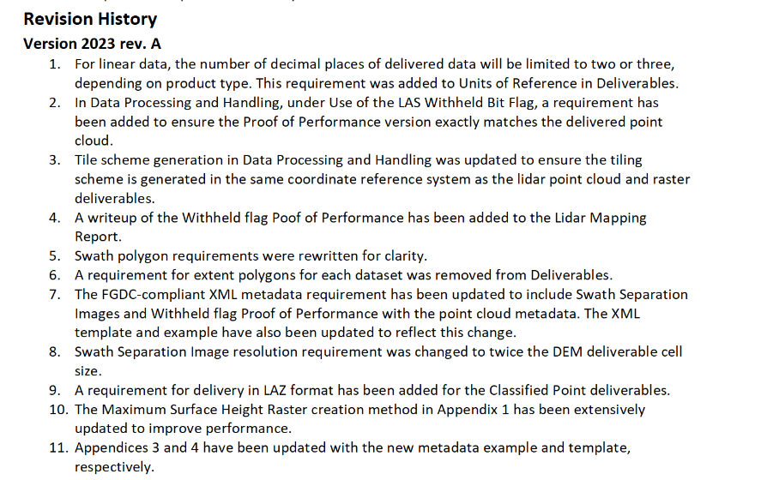
LBS 2023 rev. A
https://www.usgs.gov/ngp-standards-and-specifications/lidar-base-specification-table-contents
https://www.usgs.gov/ngp-standards-and-specifications/lidar-base-specification-revision-history#2023revA
GPSCTechnicalInquiries@usgs.gov

Slide 4
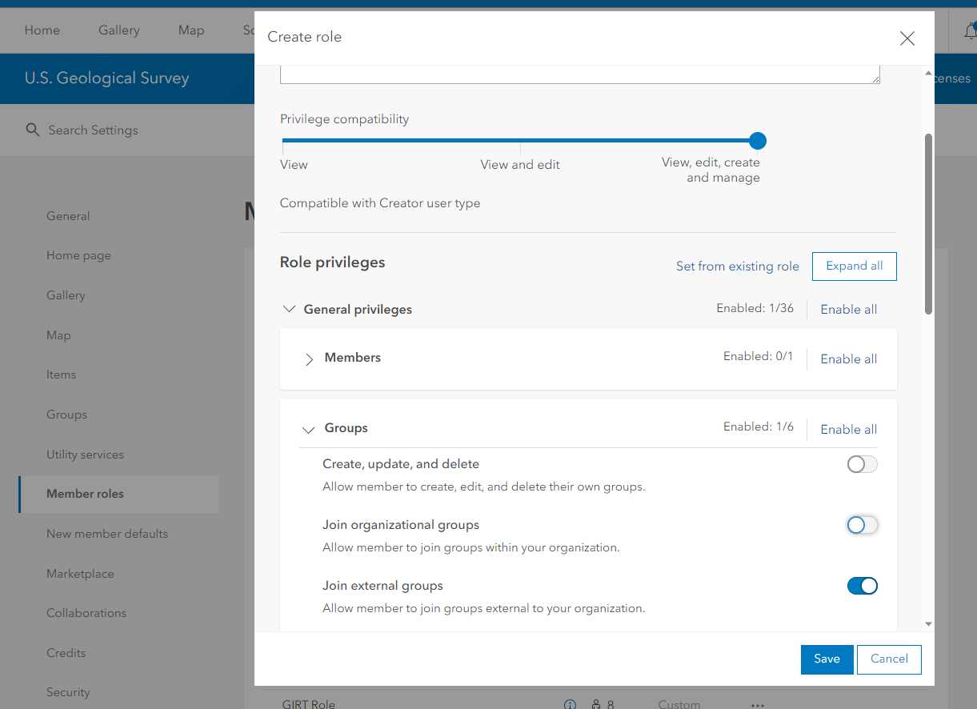
USGS AGOL 3DEP Application
Demo by Shane Wright (USGS)
GPSCTechnicalInquiries@usgs.gov

Slide 5
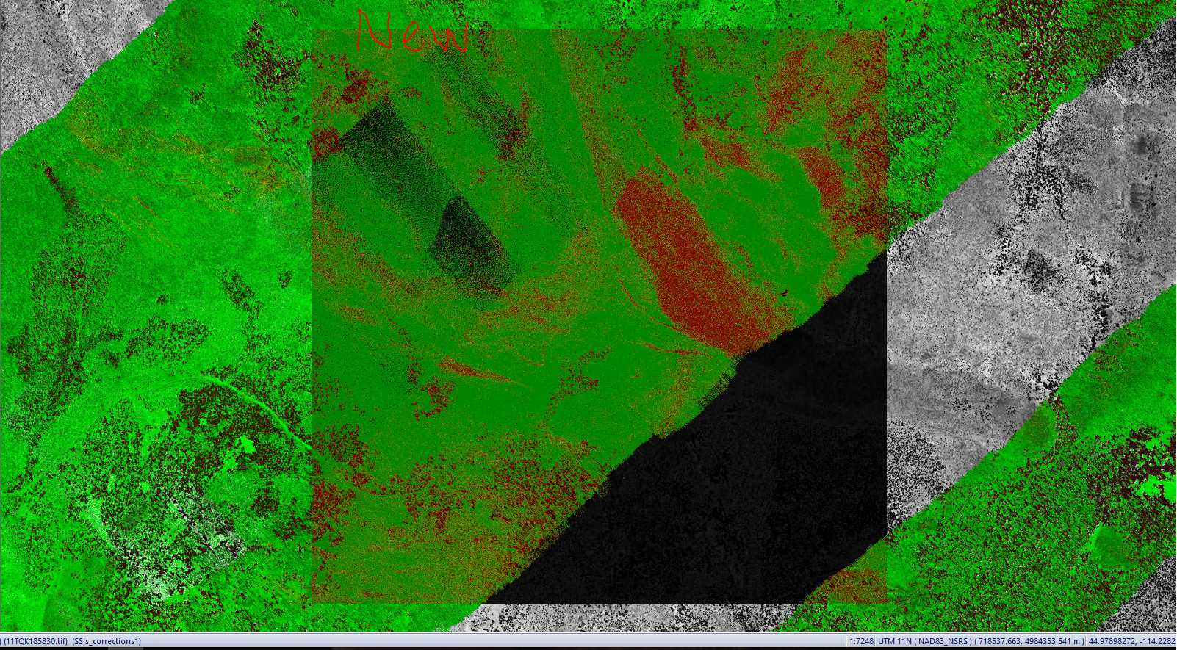
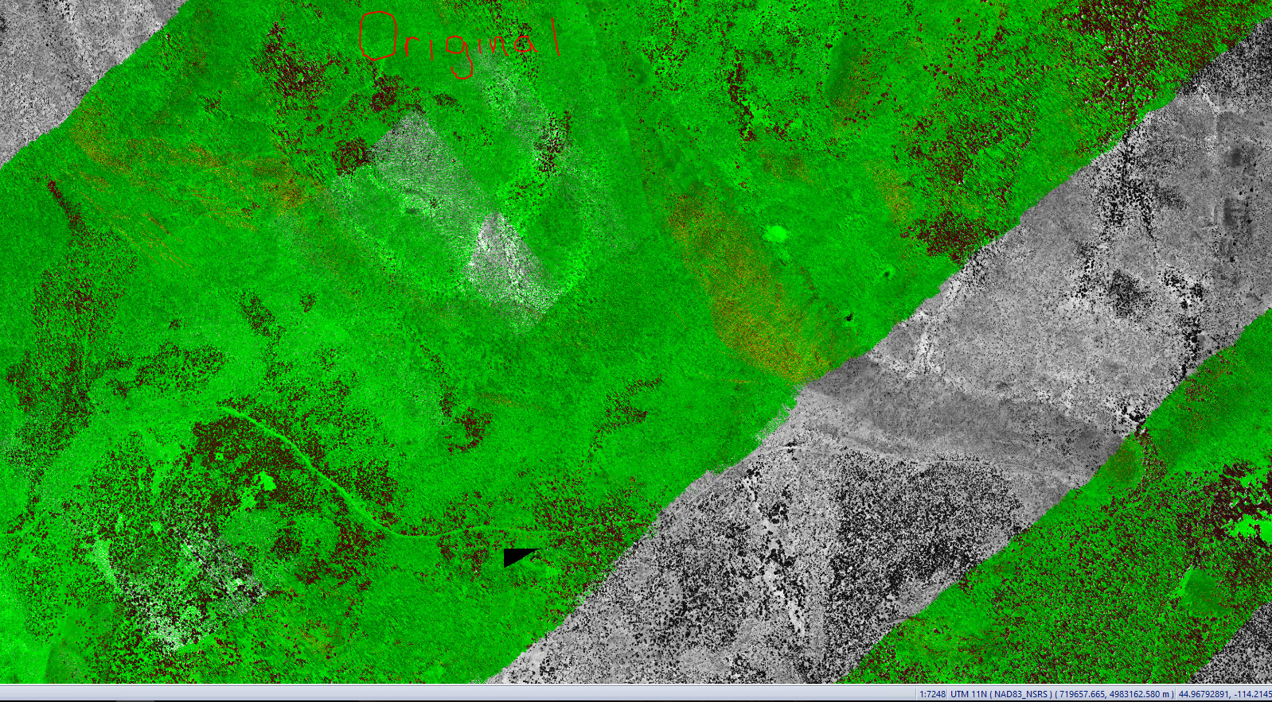
Recap of Previous TEM
USGS considering 100-pixel buffer for all work units – DISCUSSION ONLY
SSIs - Intensity data that is interpretable needed to interpret landcover, terrain, and patterns – IMPLEMENTATION ASAP
Contractors expected to provide write-up and any ancillary information used to ensure compliance with smooth surface precision and interswath precision requirements - IMPLEMENTATION ASAP
USGS does not require delivery of “polygon shapefile delineating the sample areas checked…” for smooth surface precision and interswath - IMPLEMENTATION ASAP
WU Boundary
WU A Pixel
WU B Pixel
GPSCTechnicalInquiries@usgs.gov

Slide 6
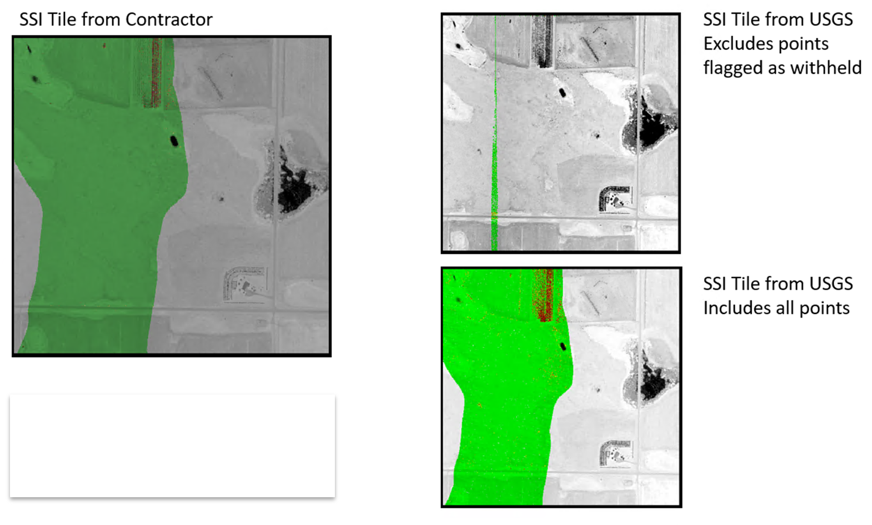
Recap of Previous TEM
Swath sidelap – DISCUSSION ONLY
We need to determine an appropriate amount of sidelap in final data that is not flagged as withheld
Only points that are determined to be invalid surface returns should be flagged as withheld, per the Lidar Base Specification
Presently, no requirement for swath sidelap – only requirement is no voids in coverage
However, some swath sidelap is needed to (1) enable geometric alignment of data and (2) assess interswath precision
Witheld points included in SSI creation
Scant sidelap makes it impossible to assess interswath precision over these areas
GPSCTechnicalInquiries@usgs.gov

Slide 7
Contractor Feedback for Correction Cycles
USGS looking to standardize contractor documentation between 3DEP and 3DHP
As part of correction cycle, please provide feedback as text file/work document
Include summary of what was fixed and what was not fixed
If not fixed, please provide explanation as to why
GPSCTechnicalInquiries@usgs.gov

Slide 8
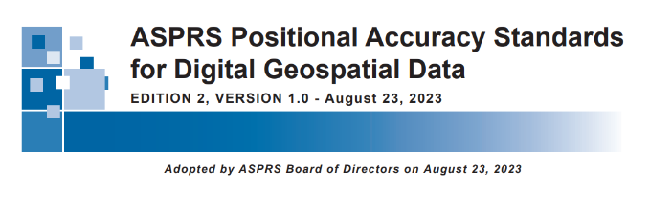
ASPRS Positional Accuracy Standards v. 2 is live – DISCUSSION ONLY
https://www.asprs.org/revisions-to-the-asprs-positional-accuracy-standards-for-geospatial-data-2023
https://publicdocuments.asprs.org/PositionalAccuracyStd-Ed2-V1
GPSCTechnicalInquiries@usgs.gov

Slide 9
Thank you!

