Slide 1
US Geological Survey’s Role in the National Hydrography Dataset and the 3D Hydrography Program
Cynthia Ritmiller
National Map Liaison
Notes:
IPDS 165189
Thanks for the opportunity to meet with you today! I’m with USGS and going to present on NHD and 3DHP
Drew Decker recently retired and I have taken over as the National Map Liaison of California as well as several other stats in the West.

Slide 2
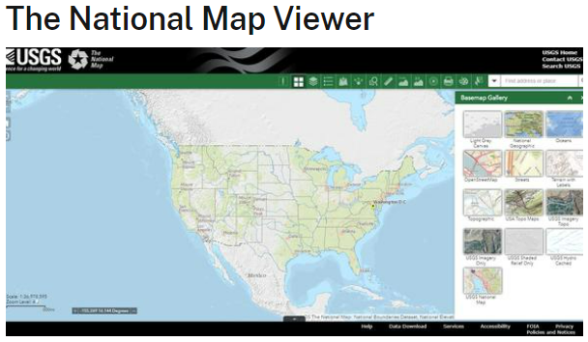
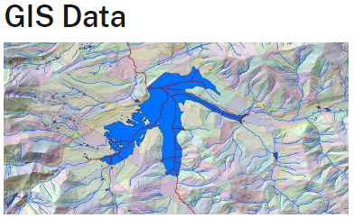
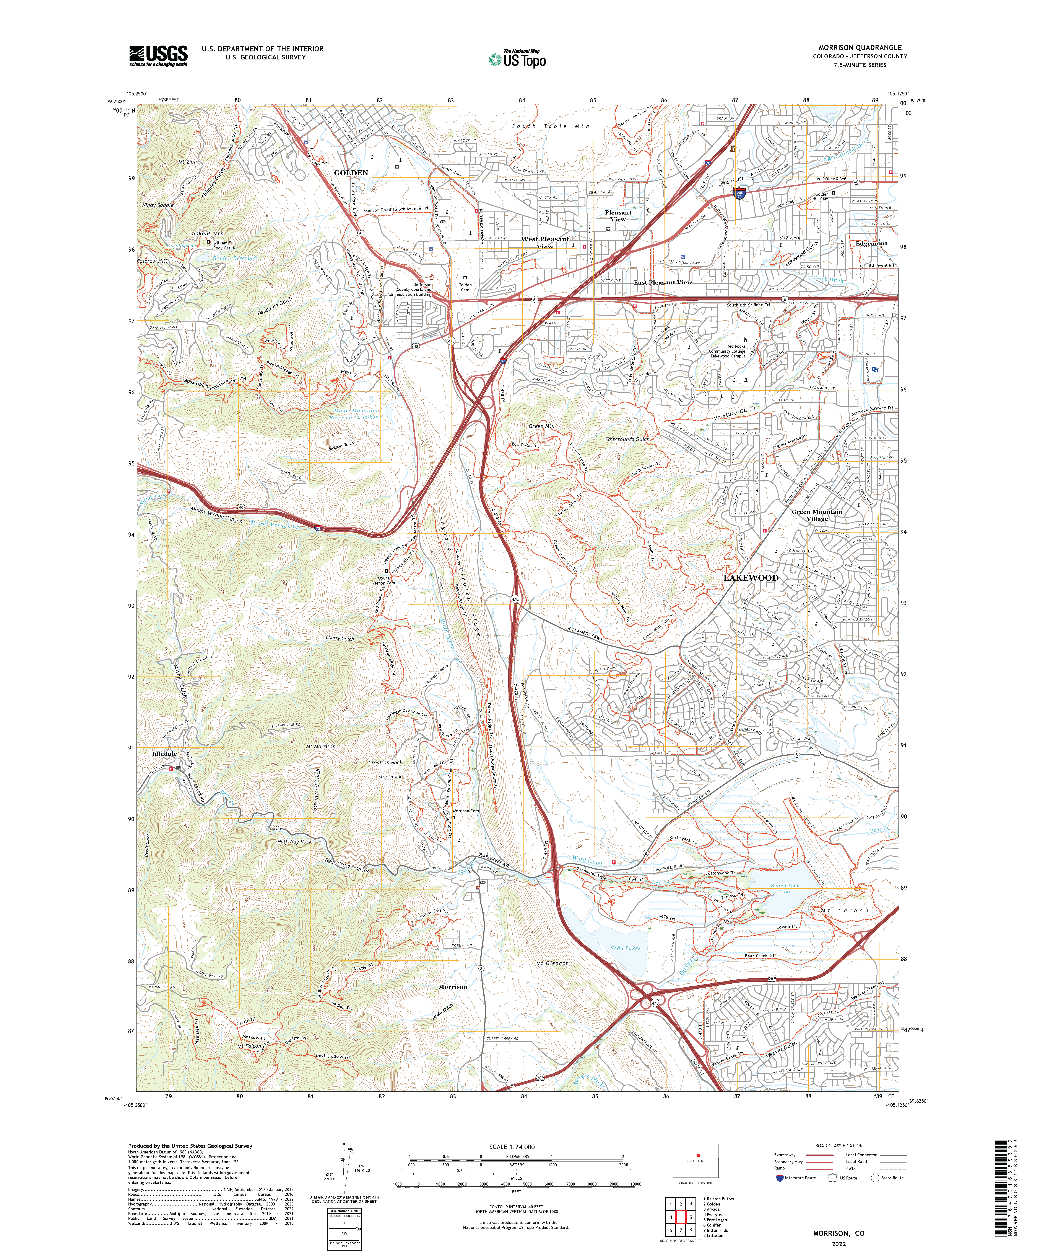

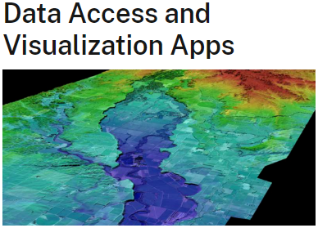
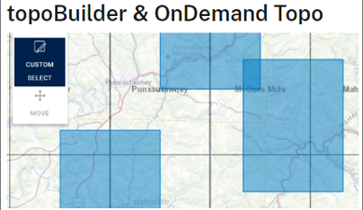
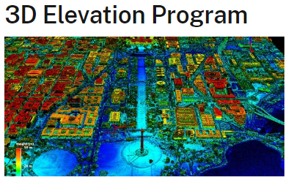
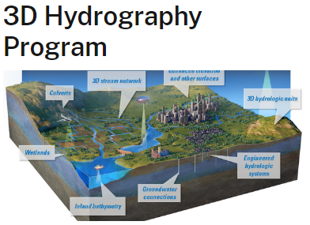
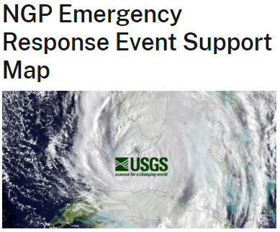
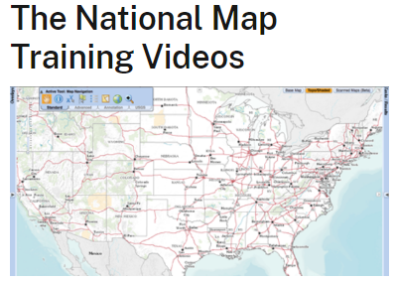

USGS National Geospatial Program
Mission: Provide National topographic information to advance science, support government, enlighten citizens, and enable decision making.
Notes:
Within USGS I’m part of the USGS National Geospatial Program(NGP).
NGP provides a foundation of digital geospatial data representing the topography, natural landscape, and manmade environment of the United States.
Here are some of the components of the NGP.
The National Map is the authoritative source for Hydrography, Elevation and Names.

Slide 3
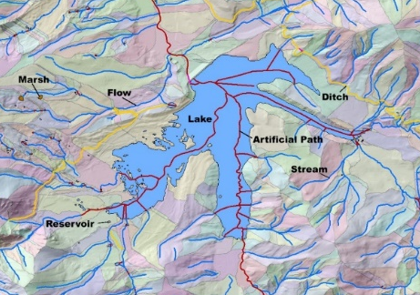
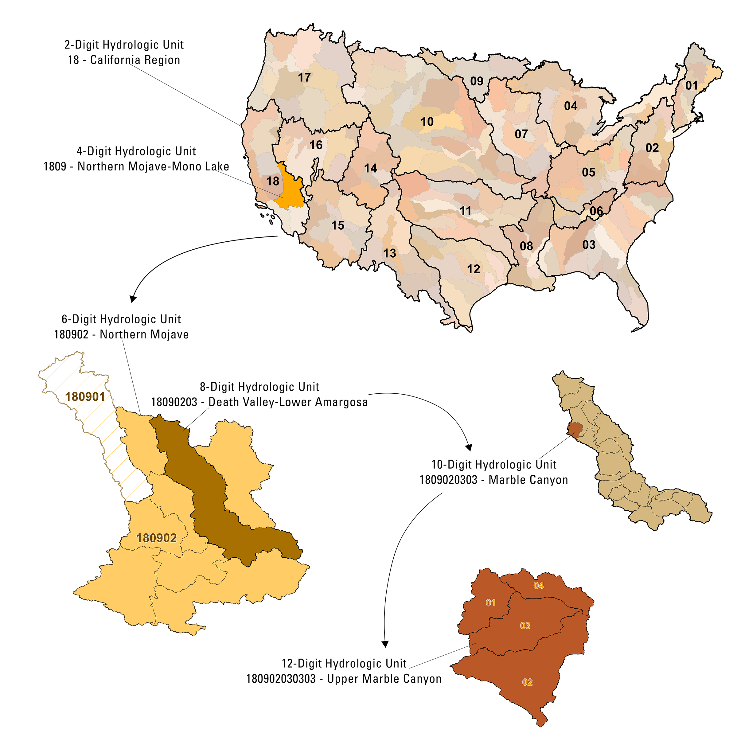
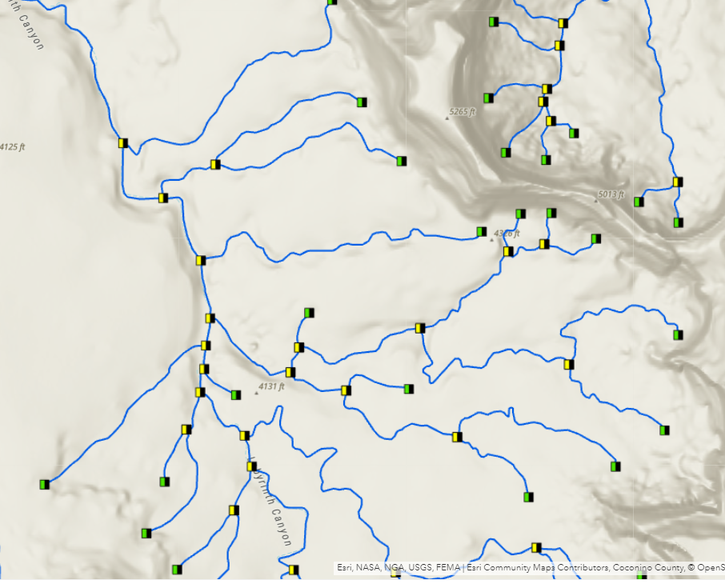
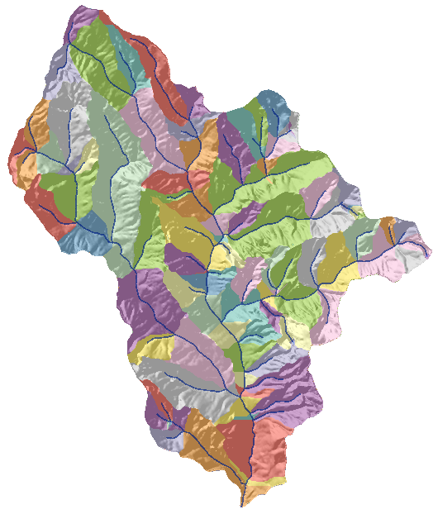
Hydrography data on The National Map
National Hydrography Dataset (NHD)
Watershed Boundary Dataset (WBD)
3D Hydrography Program (3DHP)
NHDPlus High Resolution (NHDPlus HR)
Static versions of NHD, WBD, and NHDPlus HR are available and can be found: https://www.usgs.gov/national-hydrography/access-national-hydrography-products
Notes:
Let’s look at what is the Hydrography Data is part included of The National Map.
(Click) The NHD was the first national surface water dataset. It is a powerful database that contains a flow network allowing for modeling and tracing water downstream or upstream. The majority of the NHD originally digitized from the 7.5 min topo maps. The NHD has 1:24,0000-scale or greater, with
(Click) The WBD established a drainage boundary framework. Made up of many hydrologic units (HU’s) the WBD became the containers for the NHD data.
(Click) NHDPlus HR was USGS’ first attempt at elevation derived hydrography. Using the NHD, WBD, as well as the 3DEP elevation data to derive the NHDPlus HR. NHDPlus HR provided additional features including hundreds attributes known as the NHDPlus VAA’s, catchments, as well as associated rasters. These additional features provided a more user-friendly dataset for network navigation and analysis.
The NHD and the WBD leveraged local knowledge and updates through a stewardship program with participants from 41 states and Washington, D.C. The updates to the data are not uniform. Only some areas have been updated. The national consistency of data quality has decreased over time. And NHD surface water features don’t align well with highly accurate 3DEP data.
(Click) In 2023, USGS began rebuilding a national water dataset the 3DHP.
The NHD, WBD, and NHDPlus HR are now considered legacy datasets and static versions can be found on our website.
Moving forward USGS is focused on building 3DHP

Slide 4
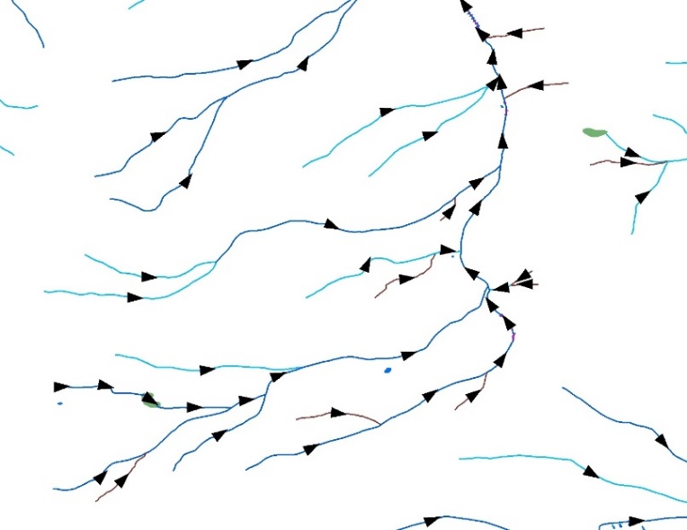
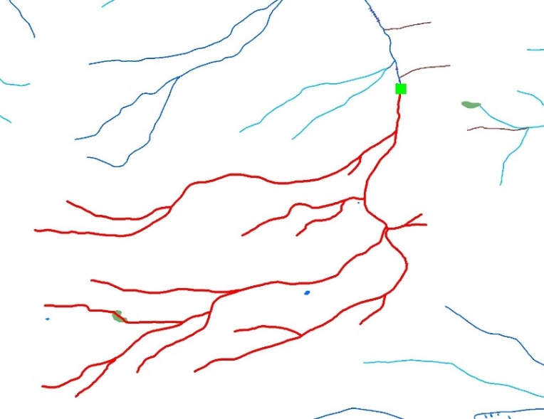
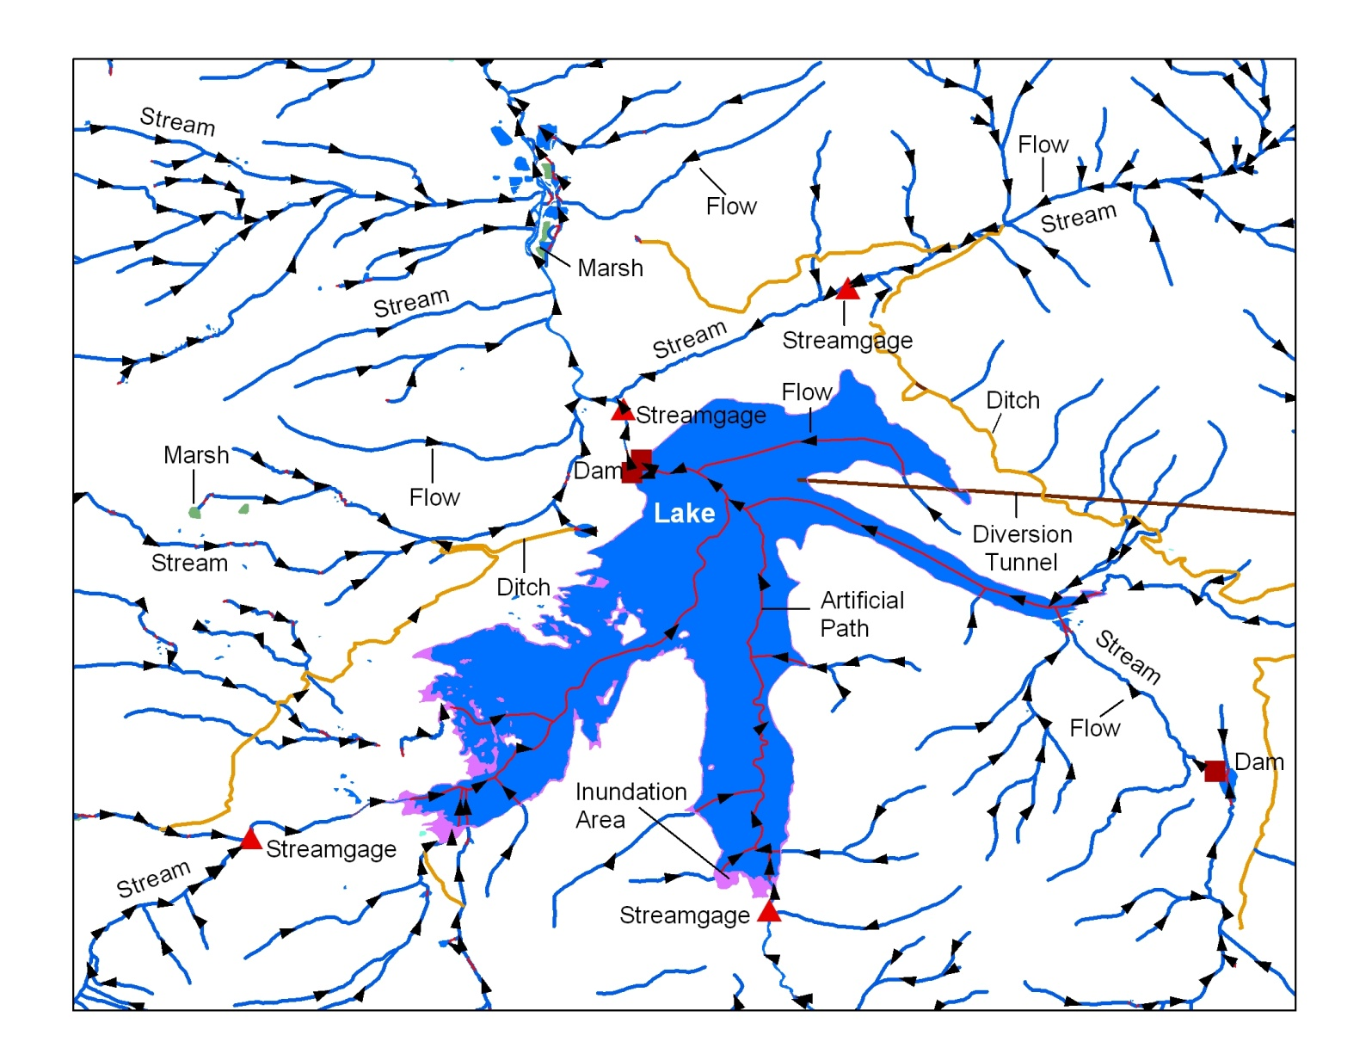
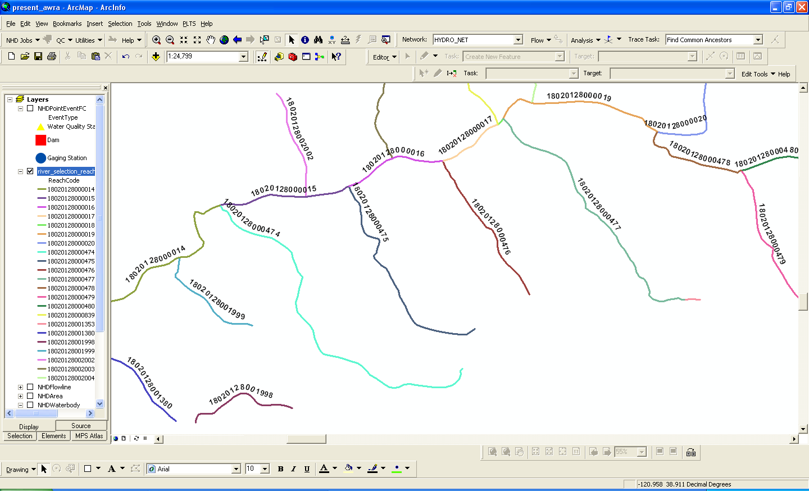
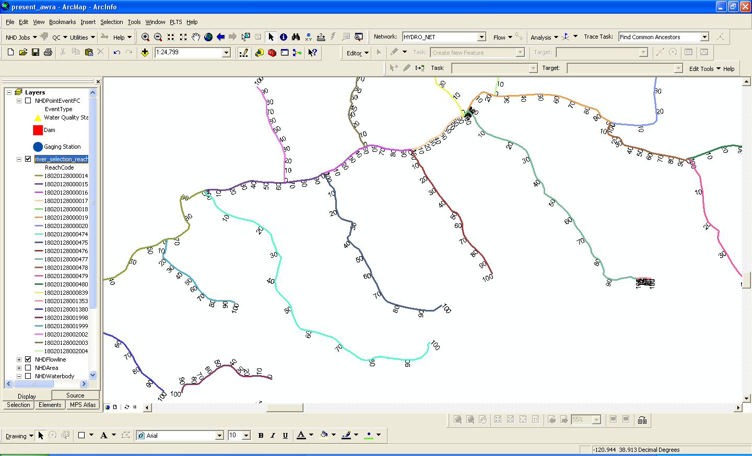
National Hydrography Dataset (NHD)
Flow Direction
Flow Navigation
Reachcodes
Measures
Notes:
First, we have the National Hydrography Datatset or NHD.
The National Hydrography Dataset (known as the NHD) is more than just blue lines on the map.
The NHD was the first national surface water dataset including features such as rivers, streams, canals, lakes, ponds, and streamgages
It is a powerful database that contains a flow network allowing for modeling and tracing water downstream or upstream.
The NHD has 1:24,0000-scale or greater, with the majority of the NHD originally digitized from the 7.5 min topo maps.
The NHD is a multi-resolution dataset because it is built from a variety of data sources, including EPA, Forest Service, and NHD partners.
Here are some of the NHD's attributes:
including flow direction, flow navigation, reachcodes, and measures.
Maintaining and improving the NHD was a challenge utilizing local knowledge through a network of state-organized stewards.
While this worked in most areas, this did not provide a nationally consistent dataset or was updated on a regular basis.

Slide 5
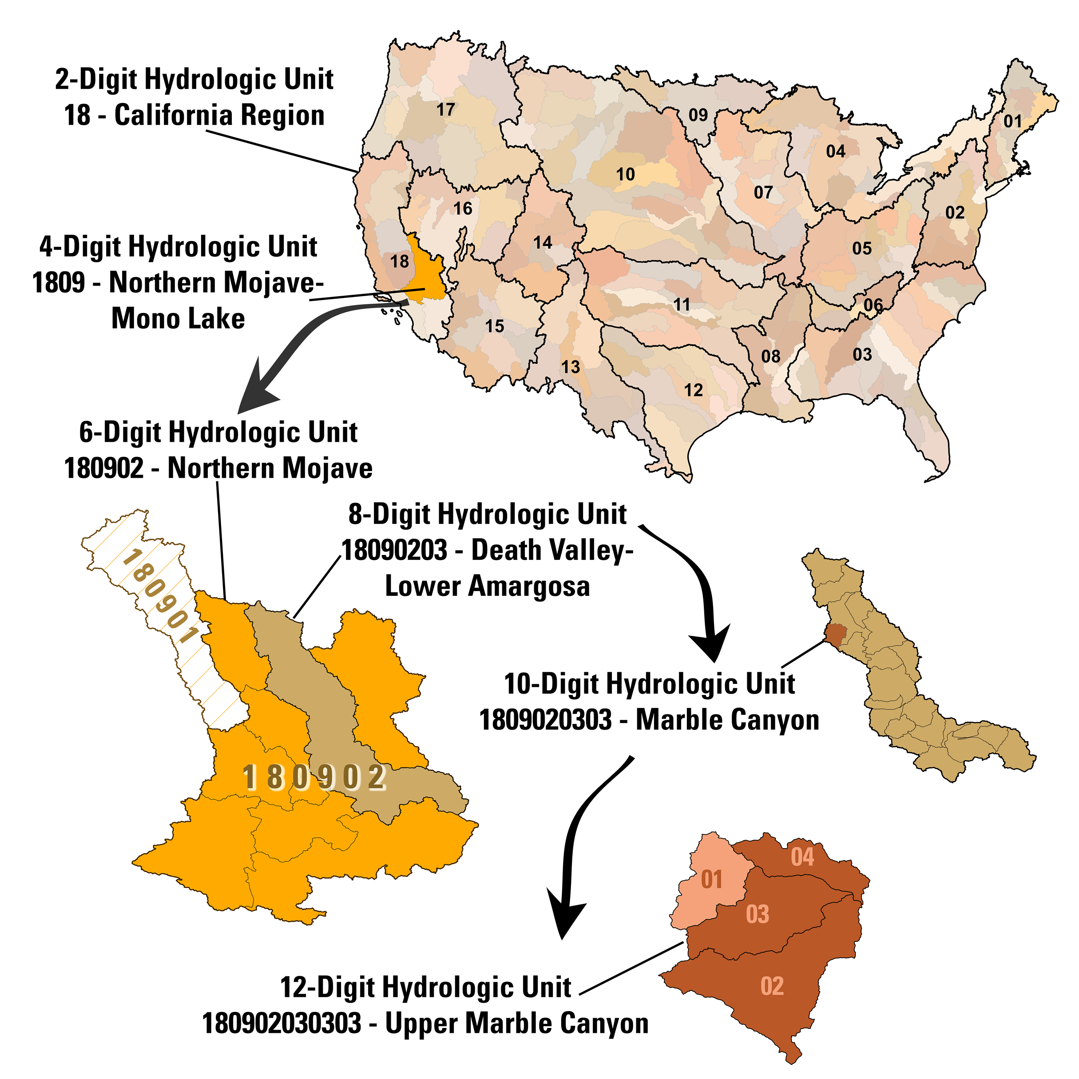
Watershed Boundary Dataset (WBD)
Seamless baseline drainage area dataset for the Nation
Boundaries defined by hydrographic and topographic criteria with no regard for administrative boundaries
Delineated in a nested multi-level, hierarchical drainage system.
Each level assigned a progressive 2-digit Hydrologic Unit (HU) code which describes where the unit is in the country and the “level” of the unit
Complete for the US to HU12
Notes:
Next is the Watershed Boundary Dataset (WBD)
- Watershed Boundaries are determined solely upon science-based hydrologic principles, not favoring any administrative boundaries or special projects, nor particular program or agency.
- The intent of defining Hydrologic Units (HU) for the Watershed Boundary Dataset is to establish a base-line drainage boundary framework, accounting for all land and surface areas.
- Hydrologic units are given a Hydrologic Unit Code which describes where the unit is in the country and the extent of that unit.
The WBD can be thought of as containers for the hydrologic features.
- The images on the right show the various HU levels from the HU2 to the HU12.

Slide 6
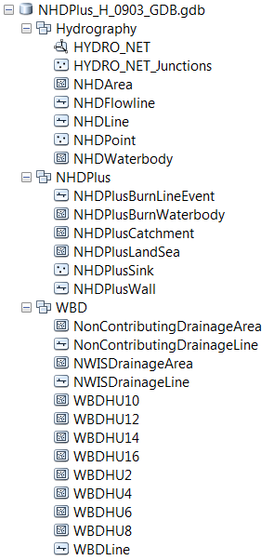
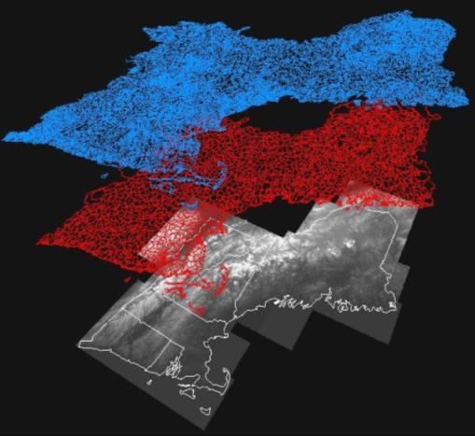
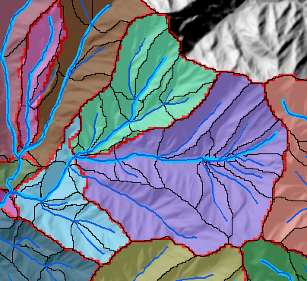
NHDPlus High Resolution (NHDPlus HR)
NHD
WBD
3DEP
Plus, additional tables…
Notes:
NHDPlus Hi Res was the one of the first phases of moving toward the integration of hydro and elevation data.
NHDPlus Hi Res, was derivated using the NHD, WBD and 3DEP datasets.
NHDPlus HR provided additional features including hundreds attributes known as the NHDPlus VAA’s, catchments, as well as associated rasters. These additional features provided a more user-friendly dataset for network navigation and analysis.

Slide 7
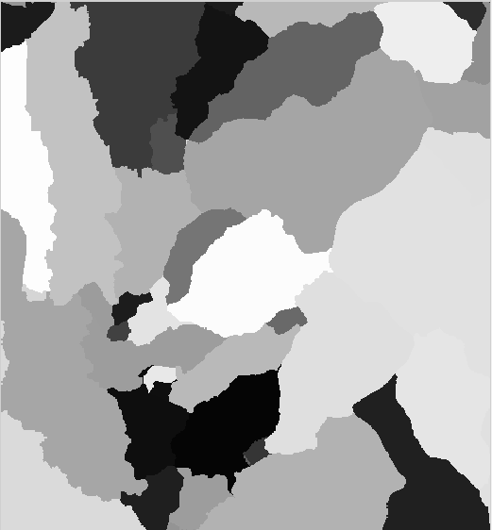
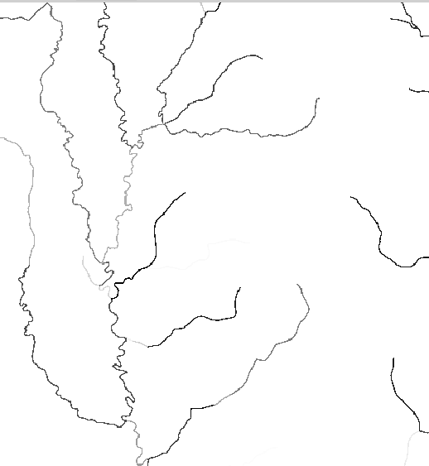

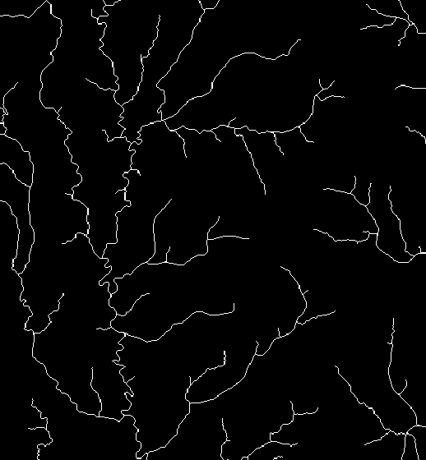
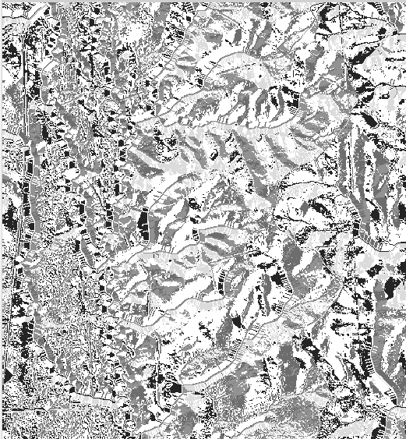
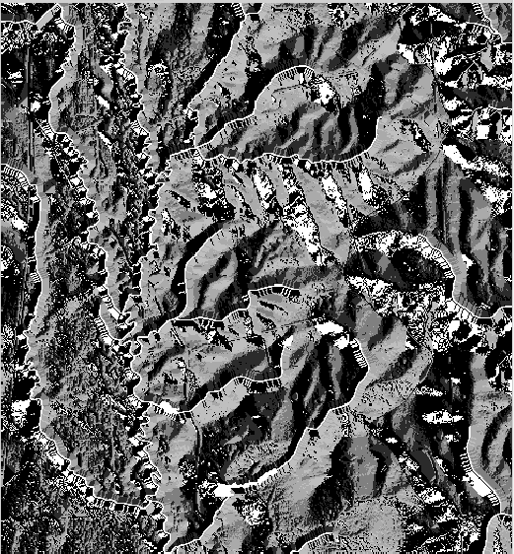
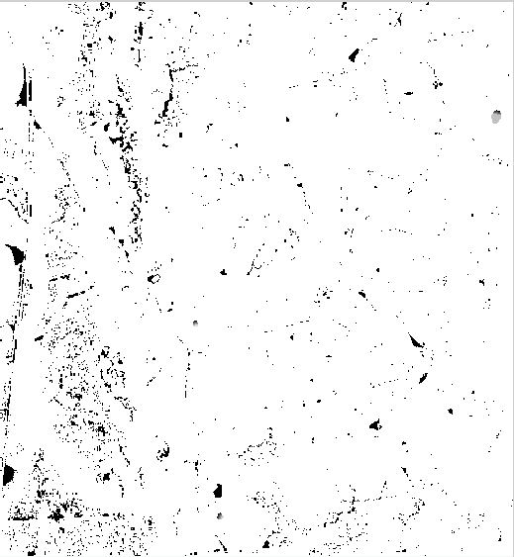
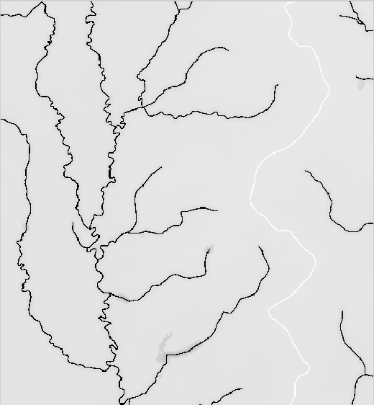
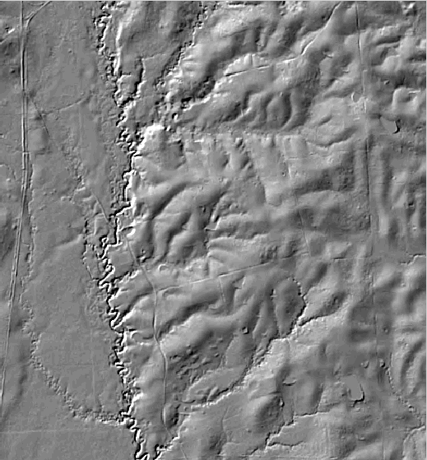
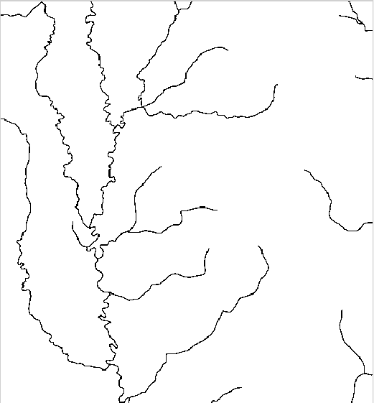
NHDPlus HR Rasters
cat.tif
catseed.tif
elev_cm.tif
fac.tif
fdr.tif
fdroverland.tif
filldepth.tif
hydrodem.tif
shdrelief.jpg
swnet.tif
Notes:
The raster data includes raster catchment files, source elevation data(elev_cm.tif), shaded relief, flow direction grids and flow accumulation rasters.
While these are raster files ie pixels you can see how some of them quickly start to look like a stream network.

Slide 8
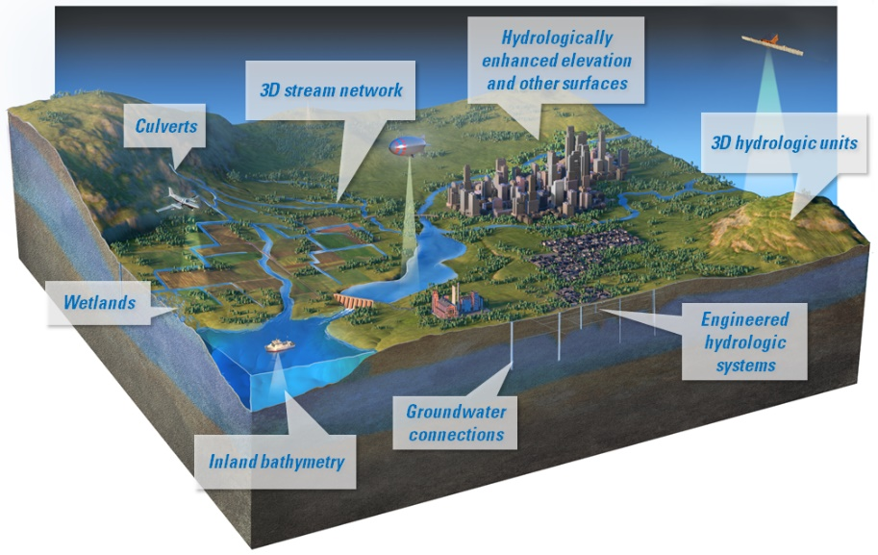
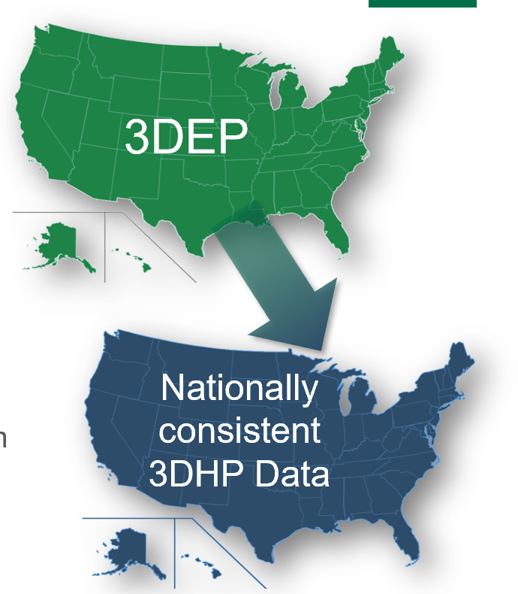
3DHP Program Goals
Replace older, inconsistent hydrography with higher accuracy data
Derive from and align with 3DEP elevation
Follow 3DEP Best Practices for governance and acquisition
Data and systems built for hydrologic applications
Better accounting of the hydrologic cycle with connections to water-related information
Interoperability with non-hydrographic data
Notes:
Building on decades of previous hydrography concepts, the 3DHP is being established to completely refresh the Nation’s hydrography data and improve discovery and sharing of water-related data.
New hydrography will be standardized to align vertically, horizontally and temporally with 3DEP data.
Transitioning the hydrography program to 3DHP, allowed us to simplify the data and resources required to maintain a nationwide hydrography dataset.
Estimations to create 3DHP are about $685M over 9 years.

Slide 9
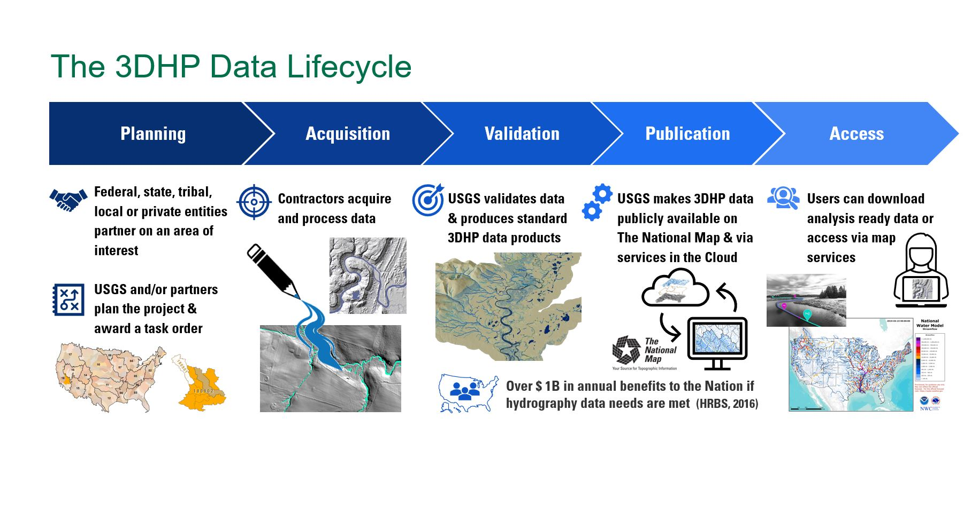
The 3DHP Data Lifecycle
Notes:
Let’s briefly walk through the steps of the 3DHP data lifecycle.
Once a 3DHP project is planned, the data will be aquired through the USGS Geospatioal G P S C or Co-op project
Validation will occur using our standand process and specifications.
Once the data has passed our validation checks, it will be distributed through The National Map and cloud services.
Once planned, a 3DHP can be acquired. Once USGS receives the data validation checks will be performed to ensure it meet our standards.
Once published, the data can be access by any users.

Slide 10
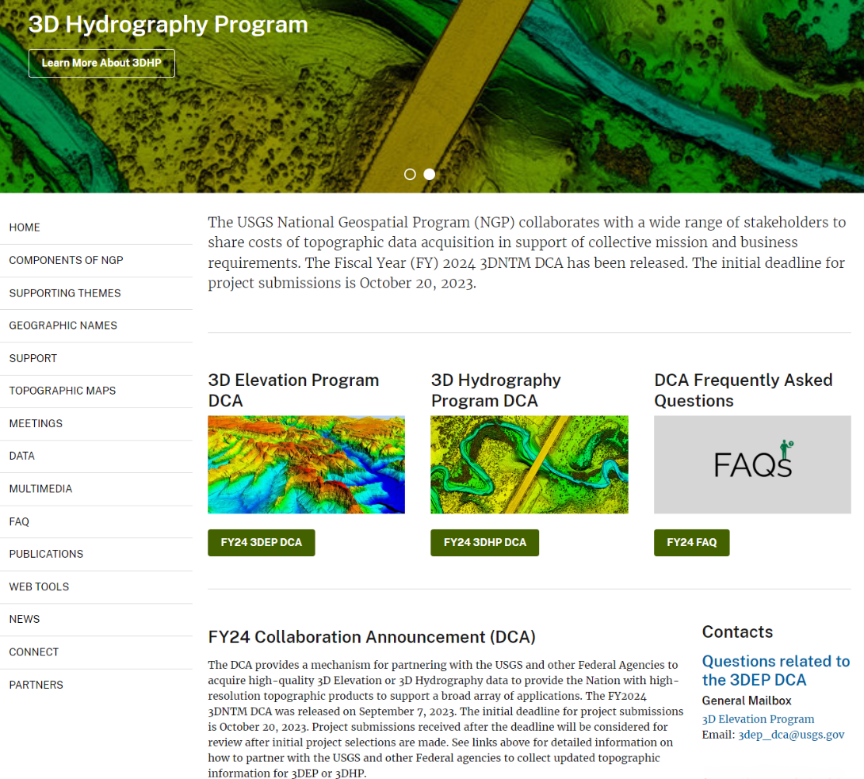
The Beginning
usgs.gov/3DNTM/DCA
Notes:
The collection of new elevation-derived hydrography will be accomplished through partnerships with local, state and federal agencies.
Coordination at all levels and across sectors is crucial.

Slide 11
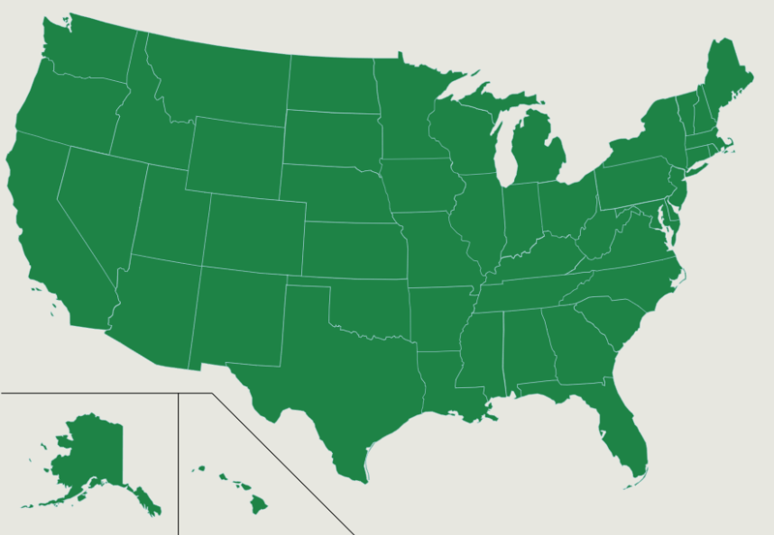

Data Collaboration Announcement (DCA)
The DCA is the mechanism used for non-federal entities to partner with USGS and other Federal agencies to acquire high-quality hydrography data for 3DHP
Open to Federal agencies, State and local governments, Tribes, academic institutions and the private sector
Applicants are encouraged to build funding coalitions to pool resources to fund 50% or more of project costs
3DHP “matching” funds added to cover remaining costs
3DEP
Nationally consistent
3DHP Data
Notes:
The DCA allows funding opportunities to collect Hydrography or elevation or in some cases both.
The application process will be largely unchanged from the BAA process and will be communicated through the USGS website; the project summary form, request for preliminary IGCE, and other application materials will be similar to the BAA
Funding proposals are submitted to USGS by partners.
I am always happy to answer questions regarding the DCA.

Slide 12
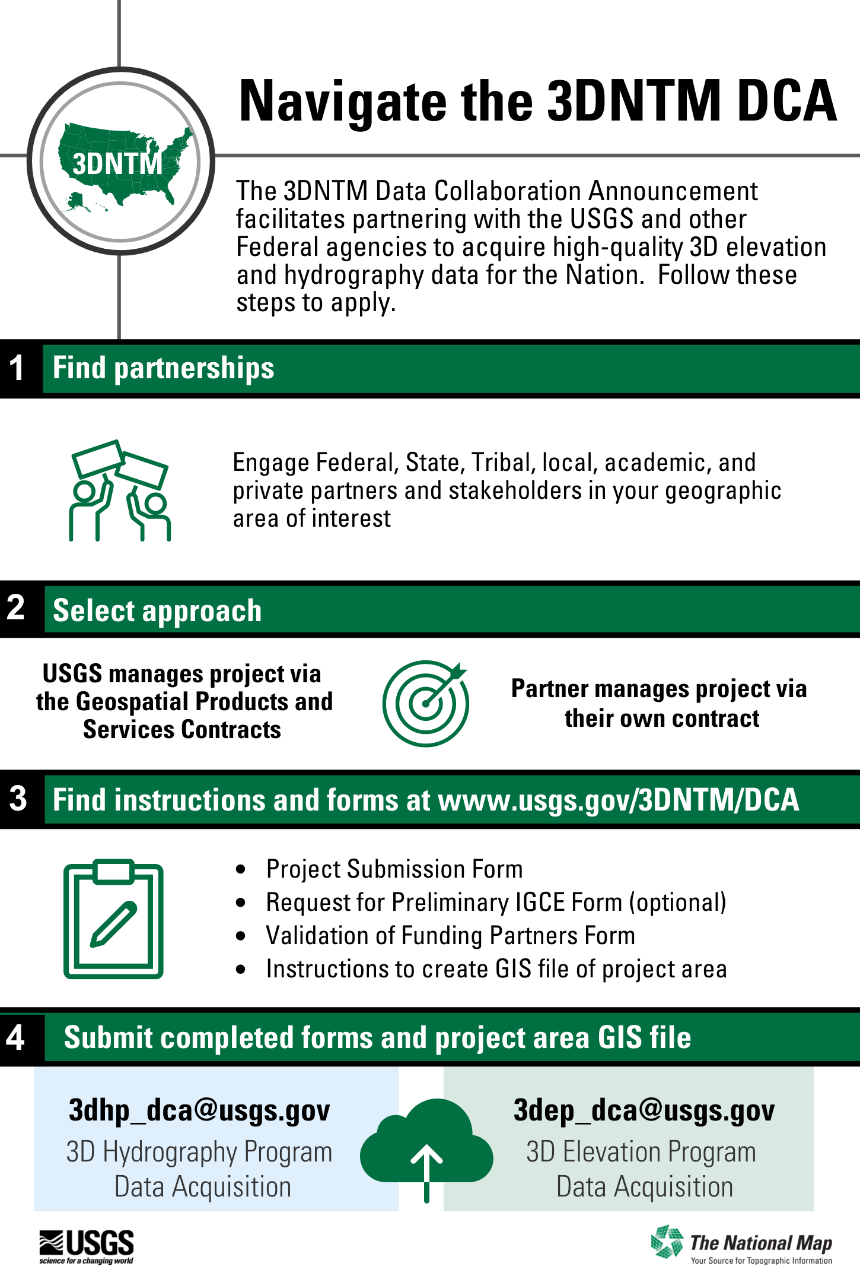
3DNTM
Data Collaboration Announcement (DCA)
Notes:
The DCA allows non-federal entities funding opportunities to collect Hydrography or Elevation or in some cases both.
Here you can see the four key steps to navigate the 3DNTM DCA.

Slide 13
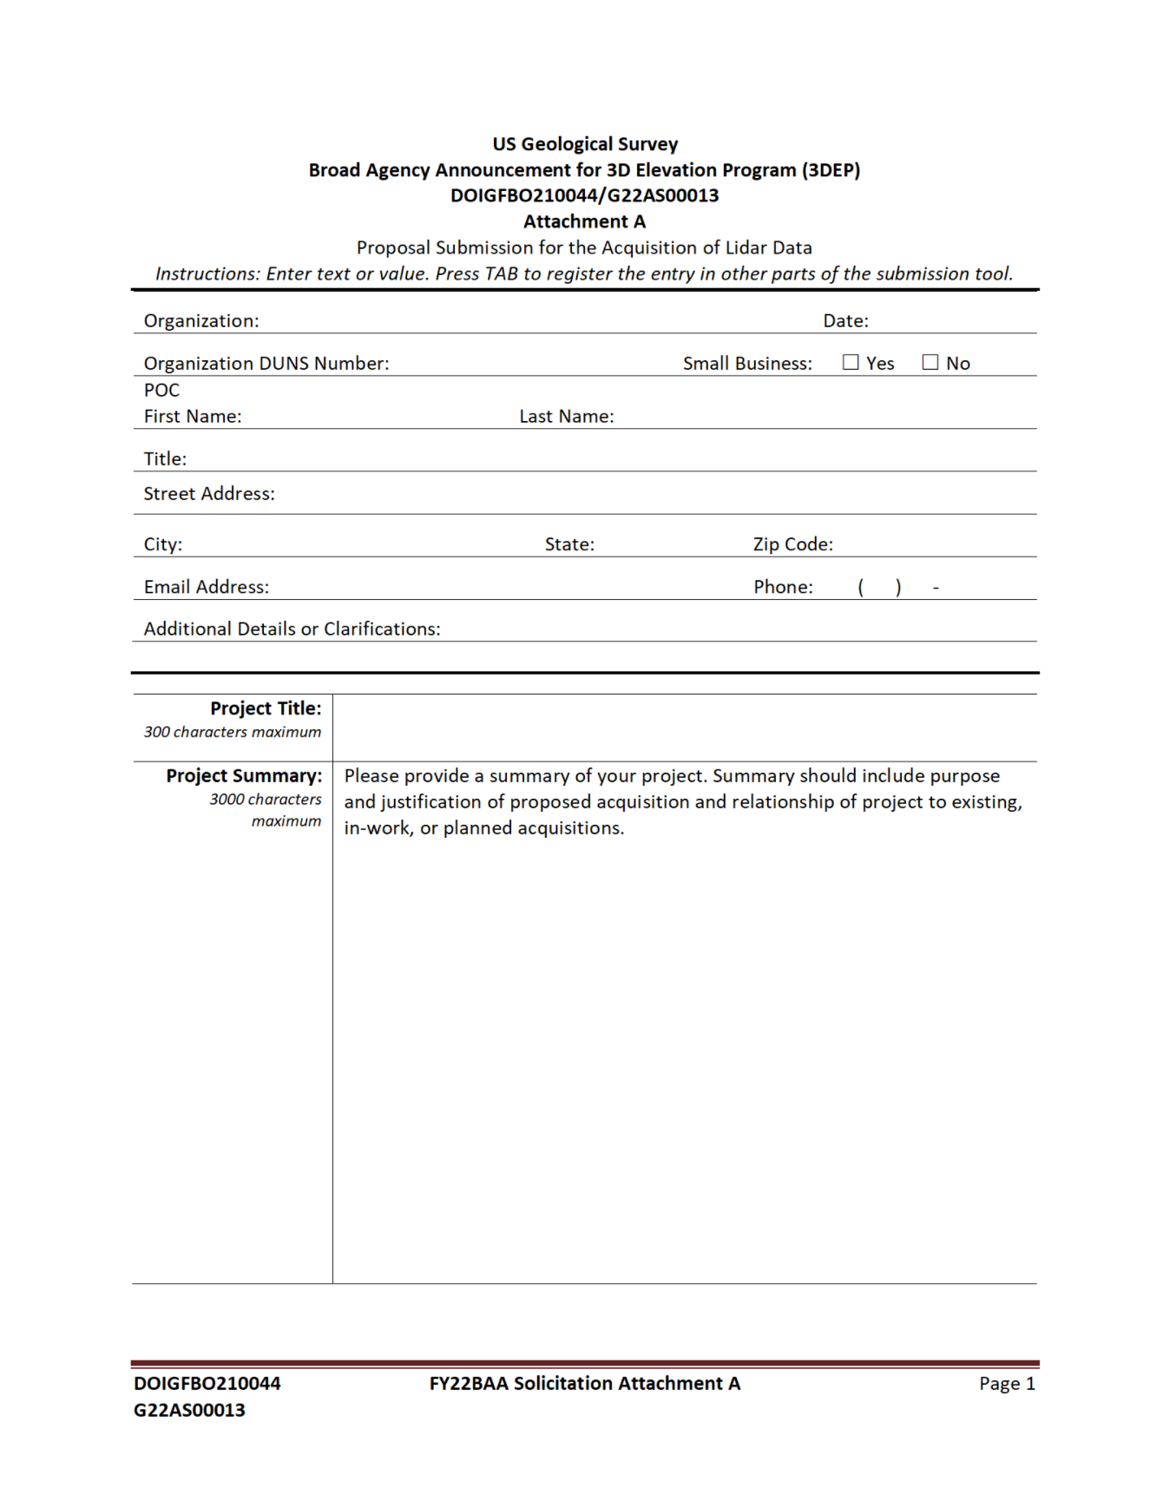
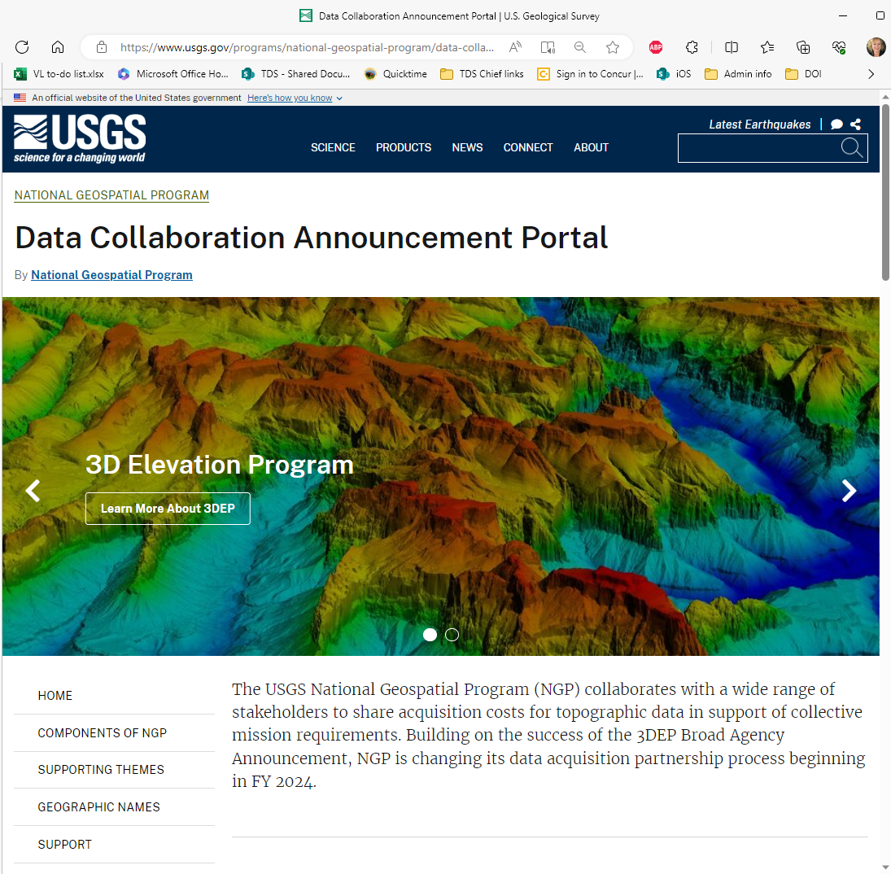
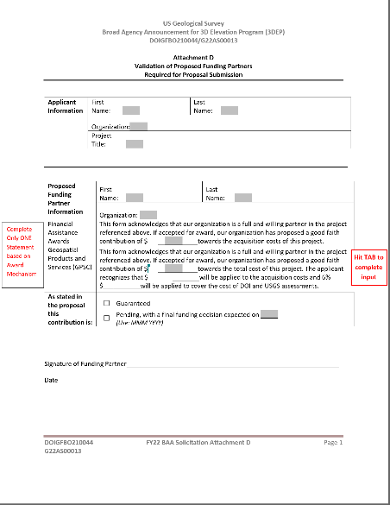
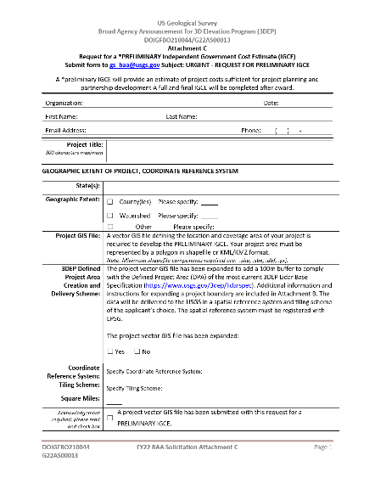

FY25 3DNTM Data Collaboration Announcement
Instructions and forms
DCA PORTAL contains all instructions and forms
WHAT YOU WILL SUBMIT
3DEP or 3DHP Project Submission Form (required)
IMPORTANT:
Hit tab to properly auto-populate the form
Validation of Funding Partners Form (required)
Request for Project Planning Estimate (optional)
GIS file of project area (required)
www.usgs.gov/3DNTM/DCA
www.usgs.gov/3DNTM/DCA
Notes:
Now let’s discuss the application process.
The DCA documentation consists of three types of documents: Instructions, Submission Forms, and Reference Materials.
All these materials will be accessed through the DCA portal at the URL on the slide.
We’ll review important aspects of each type beginning with instructions.
The DCA portal will include a page for each program that outlines important information and instructions about the project submission process. The portal will also house downloadable forms, additional instructions, and reference materials.
Most importantly, the portal will be used to communicate key deadlines for project submissions.
Next are the project submission forms. It is important to use the correct form for your project submission – 3DEP or 3DHP - and to fill it out completely. Information that is optional will be identified in the form.
The project submission form includes a checkbox that allows you to select which data acquisition option your project would use – GPSC or partner managed.
Based on the data acquisition option selected, the form will calculate the 6% GPSC assessment as appropriate, total partner funding or cost share, and the matching funds requested from USGS.
When filling out the form, it’s very important that you hit Tab where prompted or these calculations will not complete properly.
You also will be required to submit a completed form showing validation of funding for each partner included in the project submission.
This form allows funding partners to acknowledge that they have agreed to provide funding for the project submission.
USGS also will supply a form that can be used to request a Project Planning Estimate, or PPE. This estimate was called a preliminary Independent Government Cost Estimate or IGCE in the past, but we've updated that name to reduce confusion between the planning estimate and the official, confidential IGCE developed during the contracting award process.
The PPE is optional but is one way to provide the estimated cost of the total project in your project submission form. The PPE request must be completed and submitted to USGS during a time window that is provided on the DCA portal.
Both 3DEP and 3DHP will also supply a document containing instructions for creating a GIS file of your project area. This file must be submitted with the project submission form.

Slide 14









3DNTM DCA Timeline
FY26
FY28
FY27
Summer
Fall
Winter
Spring
Summer
Fall
Work can begin when project is officially awarded
USGS
All agreements must be in place 60 days prior to desired project start
Manages
Project via GPSC
Agreement Deadline for all GPSC Projects
Mid July
DCA Released
DCA Submissions
All Projects Awarded
DCA
Open
DCA Decisions
Partner Agreement(s)
(based on funding availability)
DCA Selection Notifications
SOW Development
August
Due September
FY28 DCA Released
FY28 DCA Submissions
Manages
Project via own contract
DCA
Open
Decisions
USGS Deadlines for Financial Assistance Agreements
Late March
Early May
Mid June
Partner
> $3M
> $500K
< $500K
Deadlines are approximate. Final dates will be posted at www.usgs.gov/3DNTM/DCA
Notes:
The DCA typically opens in August or Sept
Once pro

Slide 15

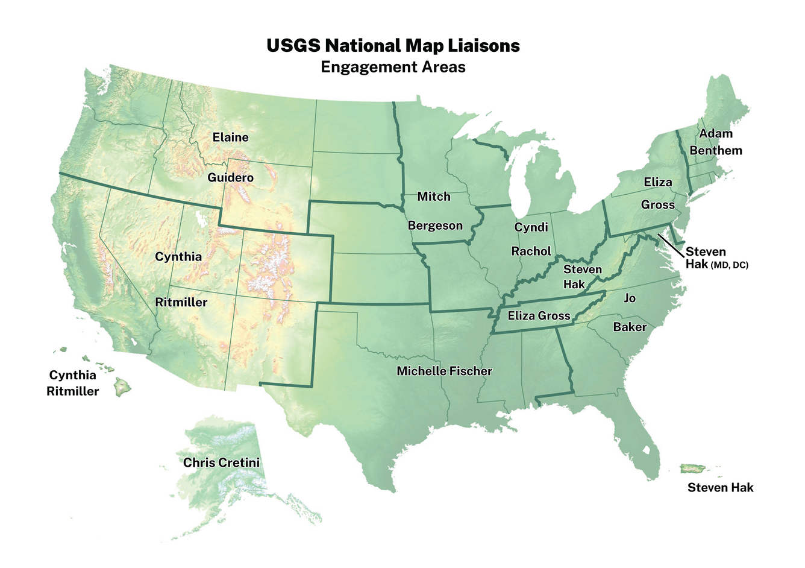
NGP User Engagement
Working relationships with partners and users are key to data acquisition and other aspects of The National Map
National Map Liaisons across the country work with states, Tribes, local governments
Other UE staff outreach to Federal partners and to national organizations
If you have questions – contact us – we are here to help!
usgs.gov/UserEngagement
Cynthia Ritmiller critmiller@usgs.gov 303-202-4550
Notes:
Part of the project planning can be including me to get a project cost estimate or see if there are other interested parties for your area of interest. Feel free to reach out with any questions.

Slide 16
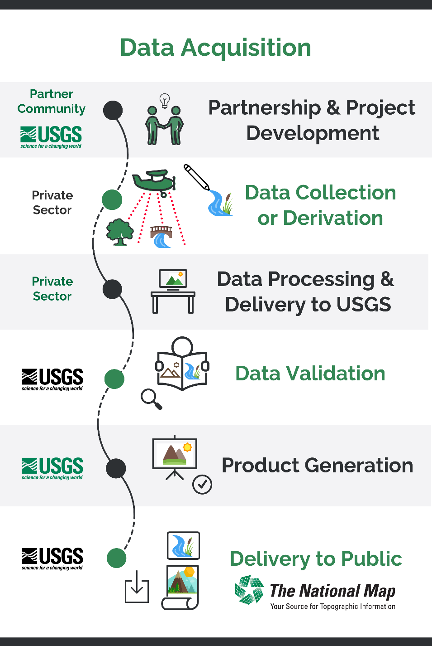
Data Acquisition Best Practices
USGS Geospatial Products and Services Contracts (GPSC)
The GPSC is a multiple award acquisition vehicle. Firms on the GPSC have been selected based on their qualifications and performance in providing the professional services needed.
The contracts include acquisition, processing, and quality assurance for mapping products (lidar and elevation derived hydrography). Managed by the USGS Commercial Partnerships Team (CPT).
USGS performs validation of the contracted data to ensure it conforms to specifications.
Option for state and local partners to manage their own acquisition contracts through a financial assistance award or cooperative agreement – may not be offered in year 1
Contributed data

Slide 17
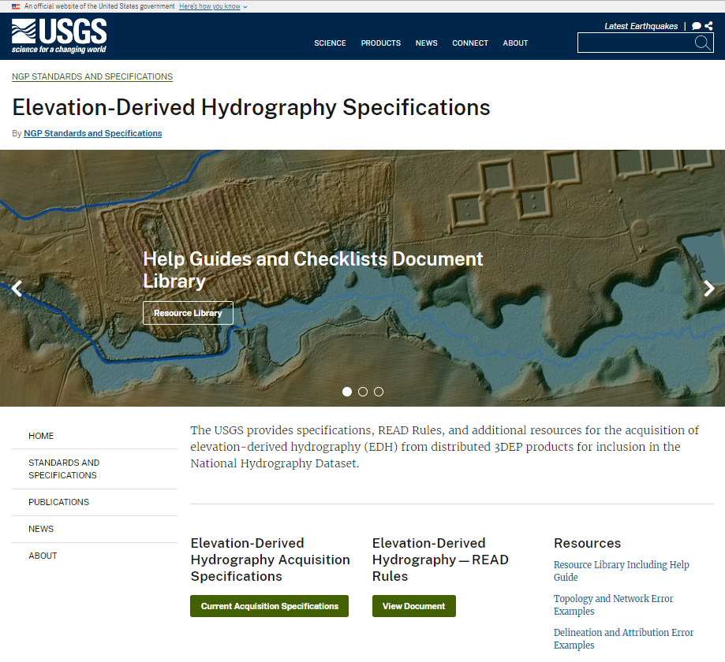
Specifications Guide Hydrography Collection
usgs.gov/3DHP/HydroSpecs
Notes:
Acquisition will occur through USGS Geospatial Products and Services Contracts (GPSC) or Co-op agreements
As data is acquired, it will be required to meet the USGS elevation derived hydrography specifications.
These specifications are published on our website and help guide the collection and validation of the new data.
(Could go to website)

Slide 18
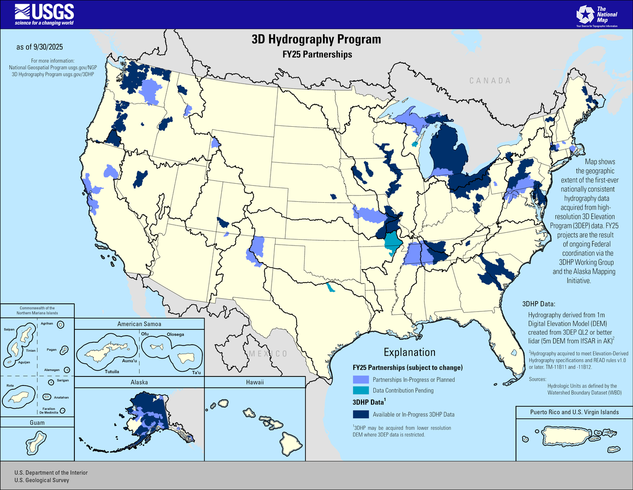
Notes:
Here is an image showing our 3DHP projects currently in work or planned.

Slide 19
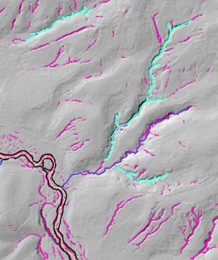
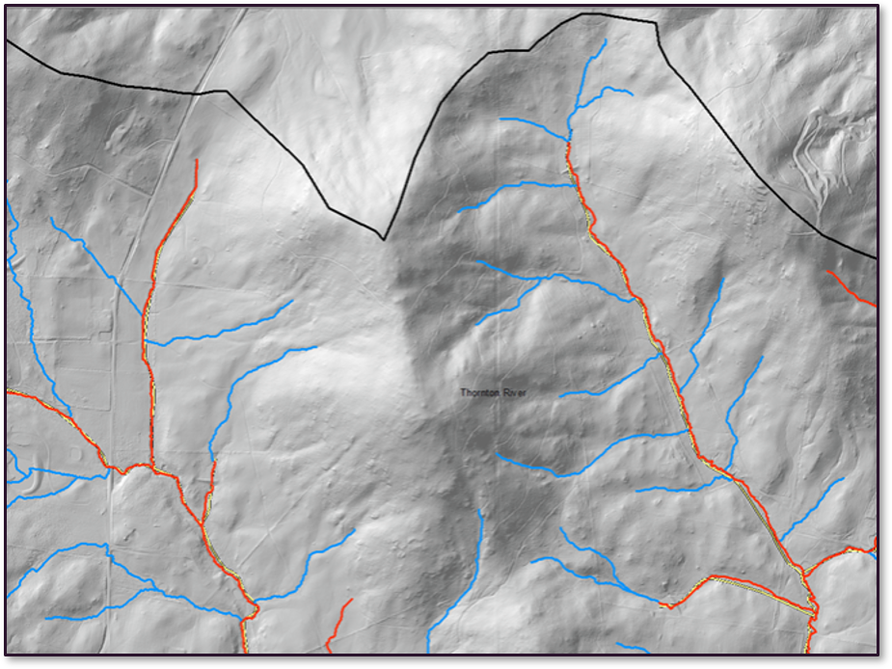
Ensuring standards are met
and Ingestion into 3DHP database
Notes:
Next, validation includes performing quality control on the source elevation derived data supplied from the contractor.
USGS will validate the network, xyz values, and double check all features have the correct feature type.
I also added the ingestion of the contracted delivered data into the 3DHP database.
While I’m not going to go into great detail about how this process works, this is where the 3DHP becomes what it is.
Additional attributes are added including flow network derivatives, catchments, mainstem network, and GNIS ID’s.

Slide 20
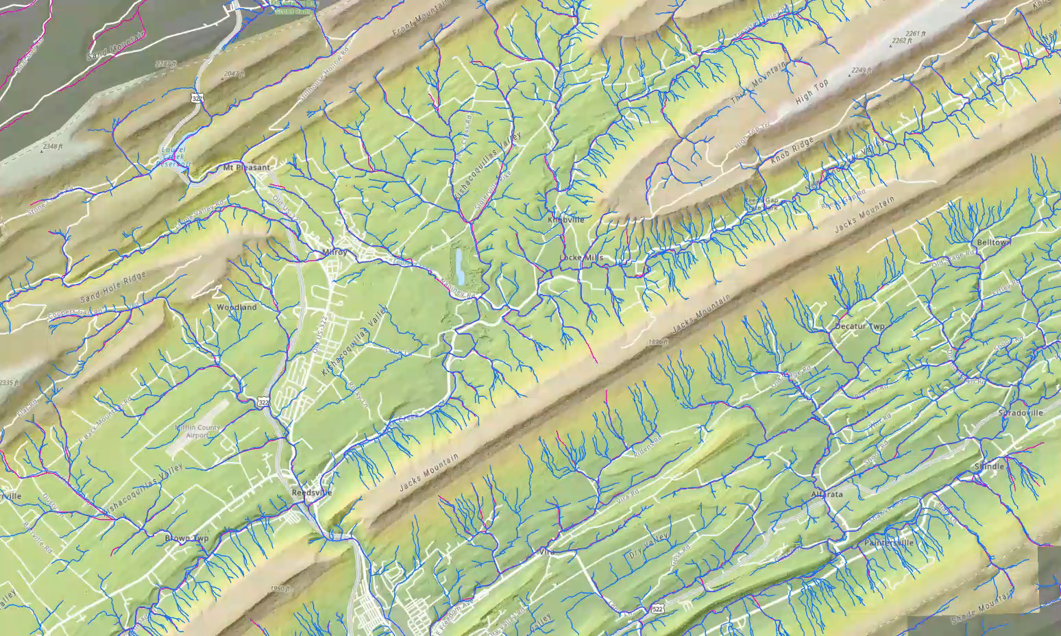
NHD vs. Hydrography derived from elevation in Pennsylvania
Notes:
Pause,
Click Play
Now let’s look at some data in Pennsylvania.
Here you can see NHD in pink and
3DHP in Blue.
You can see the increase in locational accuracy as well as the increase density of features.
Another benefit of 3DHP is the z-values on the data created more accurate data.
Let’s watch it again. (BACK ARROW, AND CLICK)

Slide 21
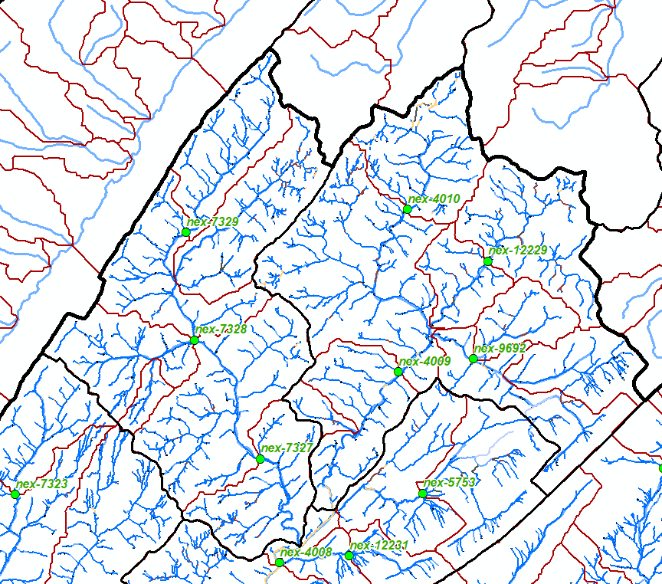

Data distribution
Notes:
3DHP data will be primarily provided through map services with an annual downloadable version.
One major benefit of services is ensuring everyone is using the same data at the same time.

Slide 22
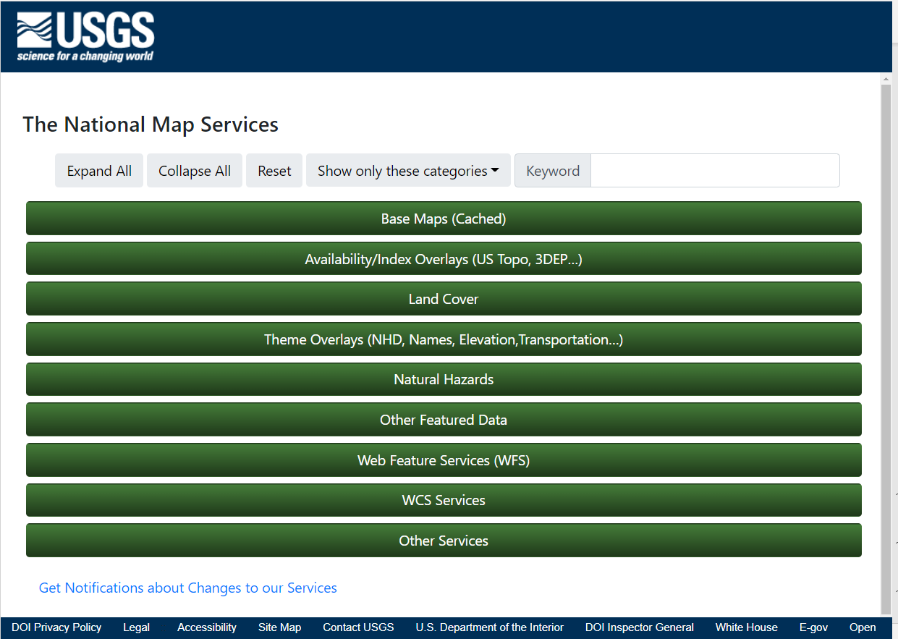

The National Map Data Access via Services
usgs.gov/3DHP/AccessData or
apps.nationalmap.gov/services/
Notes:
The last step for 3DHP lifecycle is maybe the most important part, how can users access the data.
USGS has published a web map service, a map feature service, as well as an annual
downloadable product.
The 3DHP can be accessed under Theme Overlays near the bottom under “USGS 3DHP”

Slide 23

Downloadable 3DHP Product
usgs.gov/3DHP/AccessData or
https://www.sciencebase.gov/catalog/
Notes:
The downloadable product can be found within the science base catalog or the USGS website

Slide 24

Notes:
WMS and a WFS map service is available for visualizing and querying the 3DHP_all data.
All data, NHD and Elevation-derived Hydrography sourced data provides National coverage

Slide 25





3DHP Map Service
3dhp.nationalmap.gov/
Notes:
We can see the 3DHP still contains point, line and polygon features but is much simpler than NHD or NHDPlus HR was.
The is also a drainage area feature class which will be similar to WBD.

Slide 26


3D National Topography Model (3DNTM)
3D Hydrography
Program (3DHP)
Next Gen
3D Elevation Program (3DEP)
Hydrography derived from/integrated with 3D Elevation Program data
New quality levels and refresh cycles
Connections to groundwater, wetlands, and engineered hydrography
Integration of inland bathymetry
3DEP Ecosystem for data and resource sharing
3DHP Infostructure for data sharing as part of the Internet of Water
  Continual improvement with new technologies and approaches
Future Integrated 3D Model
Research and develop a 3D data model to fully integrate 3DHP and next gen 3DEP
Integrate other data from The National Map
Notes:
USGS is in the process of building the 3-D National Topography Model or 3D N T M
The 3DNTM includes 3 components:
The first is the 3D Hydrography Program, or 3DHP.
(CLICK)
The second component is the next generation of the 3D Elevation Program. This is really targeting areas where we have data older data.
The Next Gen 3DEP will also integrate inland bathymetry.
Also as part of this, the 3DEP Ecosystem is envisioned as a federated system of data holdings allowing sharing of data, tools, code, and other resources.
(Click)
Finally, with the future being integrated elevation and hydrography data, these datasets can be further integrated with other data from The National Map.

