Slide 1
National Hydrography Dataset versus National Hydrography Dataset Plus
Cynthia Ritmiller
AWRA Conference
Notes:
Hello, my name is Cynthia Ritmiller I work for the USGS and am located in Lakewood, CO.
Today I'm going to be discussing the National Hydrography Dataset vs the National Hydrography Dataset Plus.

Slide 2
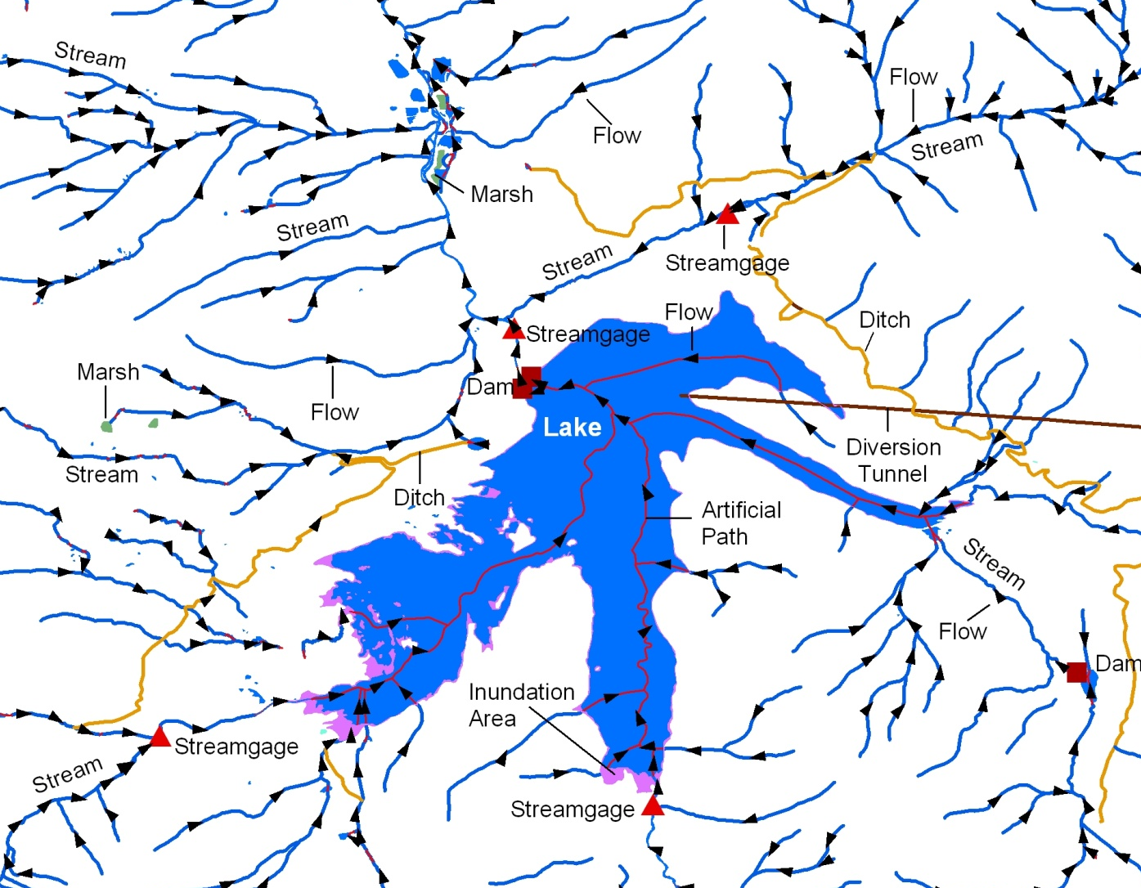
National Hydrography Dataset (NHD)
Water network for mapping and modeling
National drainage network of streams and lakes, plus other hydro info, in a GIS format
Currently 1:24K or better (1:63K – 1:24K in AK)
NHD is more than just blue lines on a map
Notes:
The National Hydrography Dataset (known as the NHD) is more than just blue lines on the map. ​
​
It is a powerful database that contains a flow network allowing for modeling and tracing water downstream or upstream. ​
​
- The NHD covers the nation, representing a national network of streams, lakes and related features in a format that is used in a geographic information system (GIS) for analysis. ​
​
The NHD has 1:24,0000-scale or greater. ​
The NHD is a multi-resolution dataset because it is built from a variety of data sources, including EPA, Forest Service, and NHD partners.​

Slide 3
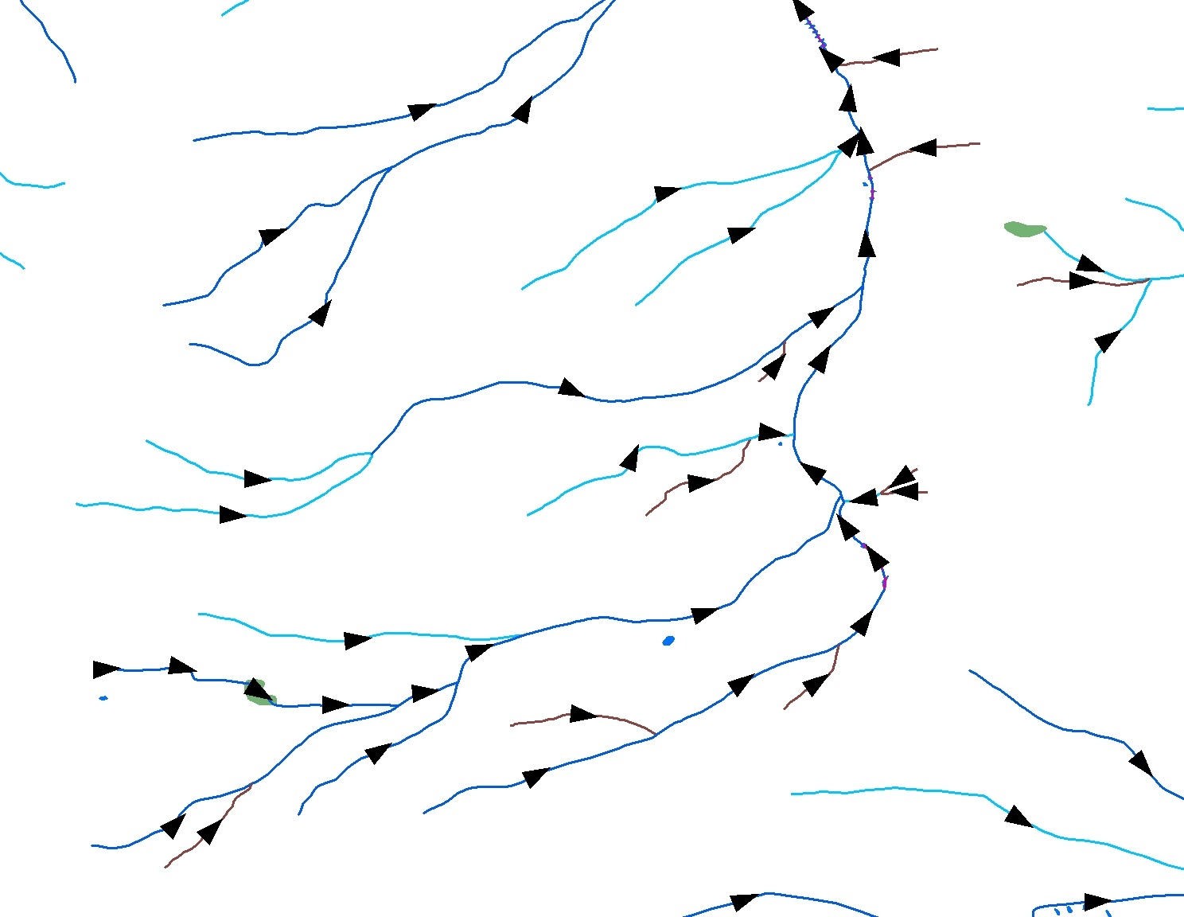
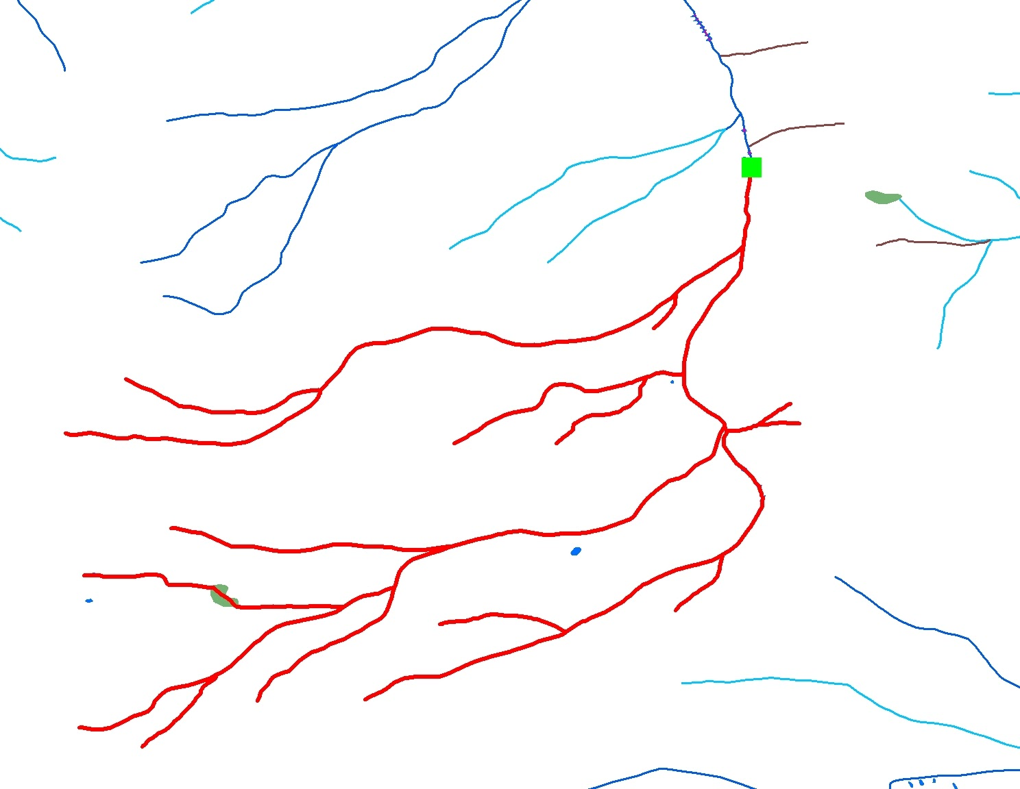
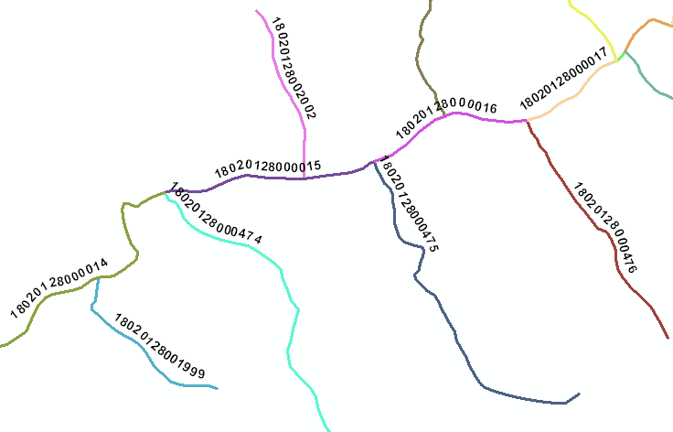
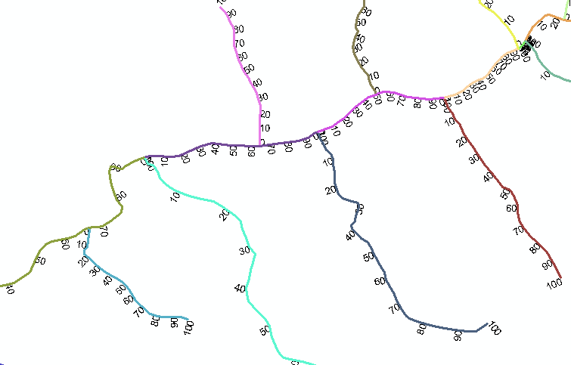
National Hydrography Dataset (NHD)
Flow Direction
Flow Navigation
Reachcodes
Measures
Notes:
Here are some of the NHD's attributes: ​
​
With a few exceptions we know the direction of flow for almost all features within the NHD. (Exceptions include some canal-ditch networks, disconnected networks, and very flat areas.) ​
​
Using flow direction with GIS software, we can analytically and rapidly determine all the upstream or downstream features. ​
​
The NHD also contains reaches and measures. ​
The definition of a reach is a stretch of river, from confluence to confluence, with similar hydrologic characteristics. Each reach is given a specific identifier ie a reachcode allowing the user a method to find a specific feature within the NHD. ​
​
All reaches have measures. No matter the length of the reach, the measure is 0 to 100. That is why the numbers are crunched up on short lines. ​
With 100 being the upstream end of the reach or the “from” end. ​
With 0 being the downstream end of the reach or the “to” end.​

Slide 4
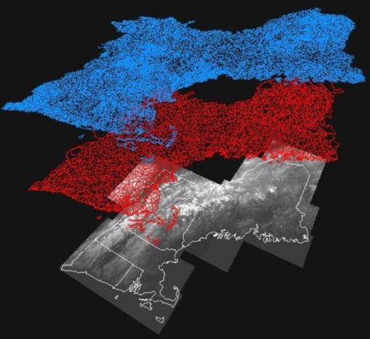
National Hydrography Dataset Plus (NHDPlus)
NHD
Incorporates features of the NHD, WBD and 3DEP elevation data to create a networked hydrography framework that incorporates the entire landscape.
NHDPlus v2 (Med Res) 1:100k
NHDPlus High Resolution (NHDPlus HR) 1:24k
WBD
3DEP
Notes:
The NHD having a built network allows many things including the creation of NHDPlus. ​
​
NHDPlus is an application ready dataset. Removing some analytical work for the user. ​
By integrating the NHD, watershed boundary dataset (WBD), and the National Elevation dataset​
(3DEP) NHDPlus allows for even more analysis. ​
​
The EPA, Horizon Systems and USGS produced medium resolution NHDPlus data at 1:100 thousand scale in 2006 with a second version released in 2012. ​
​
The USGS and Horizon Systems are currently in the process of creating High resolution NHDPlus data at 1:24 thousand scale. ​
For the remainder of this presentation I will focus NHDPlus High Res which I will refer to as NHDPlus HR. ​

Slide 5
NHDPlus Value Added Attributes(NHDPlus VAAs)
Analysis NHDPlus VAA’s Navigation NHDPlus VAAs
StreamOrder
StreamCalculator
ArbolateSum
ReturnDivergence
PathLength
FromNode/ToNode
Hydroseq
LevelPathID
TerminalPathID
StreamLevel
  Divergence
  StartFlag
  TerminalFlag
  VPUIn/VPUOut
  UpLevelPathID
UpHydroSeq
DnStreamLevel
DnLevelPathID
DnMinorHydroseq
DnDrainCount
The result of building NHDPlus HR is a set of value added geospatial layers and hundreds of attributes.
Many of the attributes are computed from the analysis of the NHD network.
These attributes are designed to make the NHD network more powerful and easier to use.
Notes:
​
The result of building NHDPlus HR is a set of value added geospatial layers and hundreds of attributes. otherwise known as the NHDPlus VAA’s​
Many of the attributes are computed from the analysis of the NHD network.​
These attributes are designed to make the NHD network more powerful and easier to use.​
These include​:
-improved NHD names and networking​
-value-added attributes (such as stream order) that enable advanced query, analysis and display ​
-elevation-derived catchments that integrate the land surface with the network ​
-catchment attributes (such as temperature, precipitation, land cover)​
-stream flow volume and velocity estimates for pollutant dilution modeling​
-associated flow direction and accumulation grids​
​
Having these attributes within your data also make attribute navigation easier.​

Slide 6
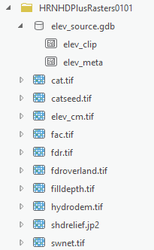
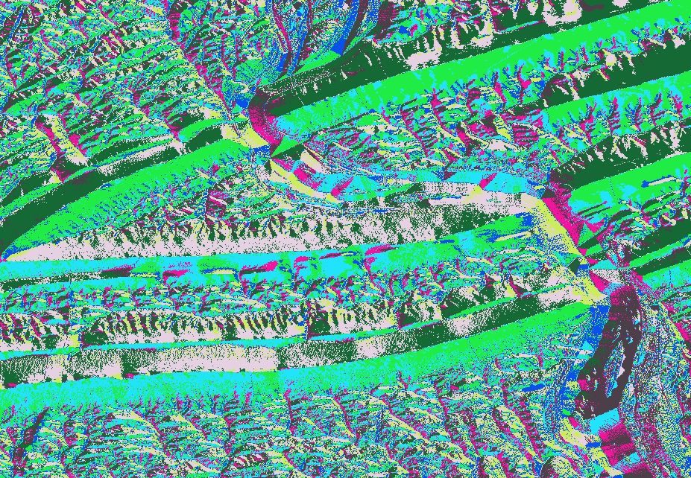
NHDPlus Raster Data
Notes:
The elevation data is incorporated and distributed within the NHDPlus HR raster data. ​
The NHDPlus HR includes information on the elevation as well as 10 rasters files.​
​
​
​
​

Slide 7
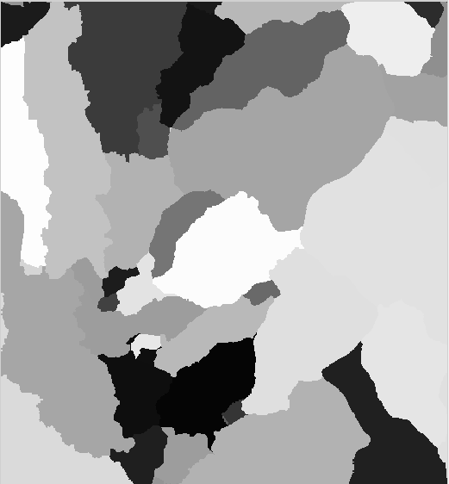
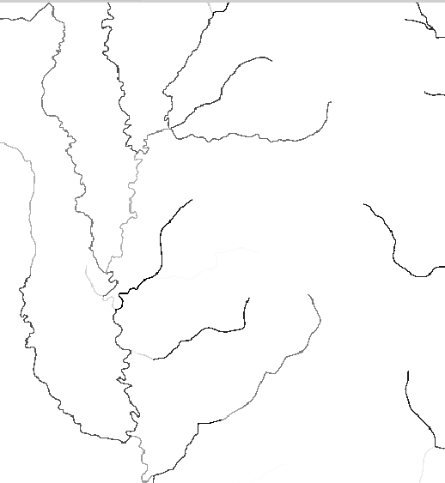
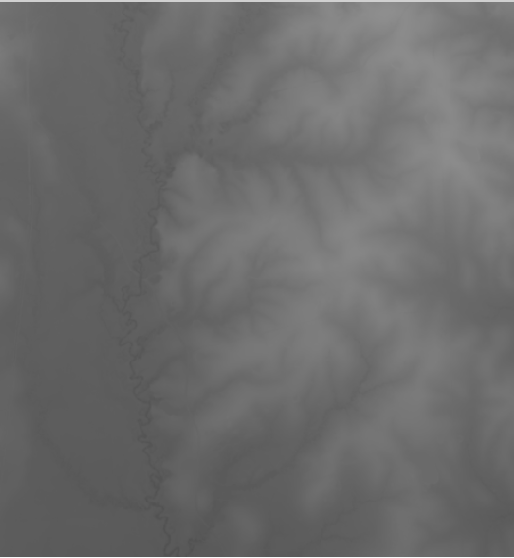
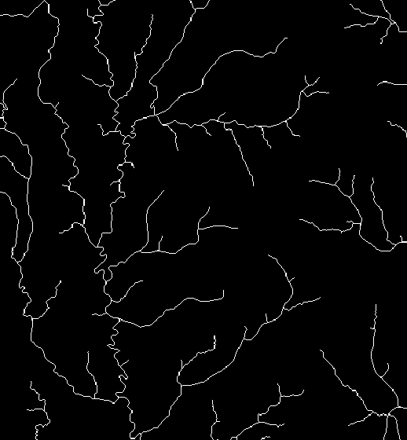
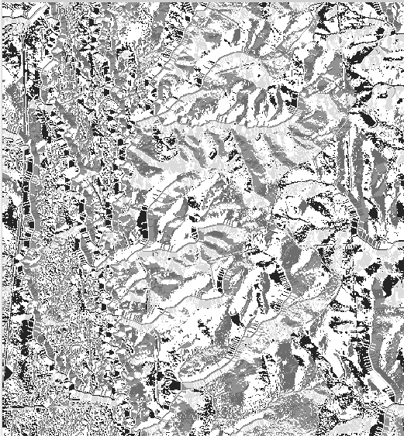
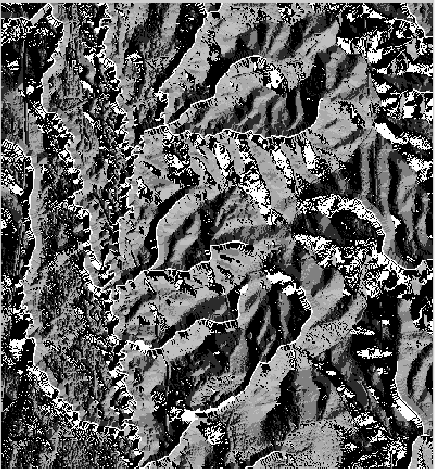
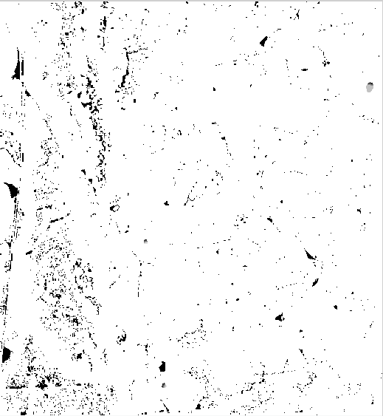
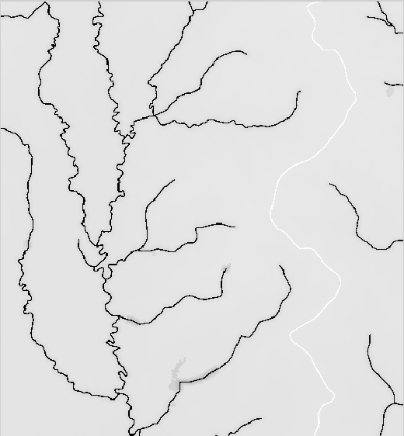
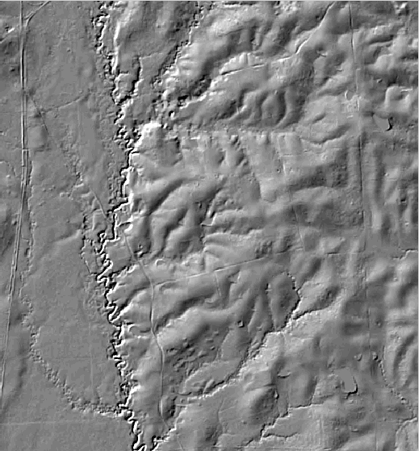
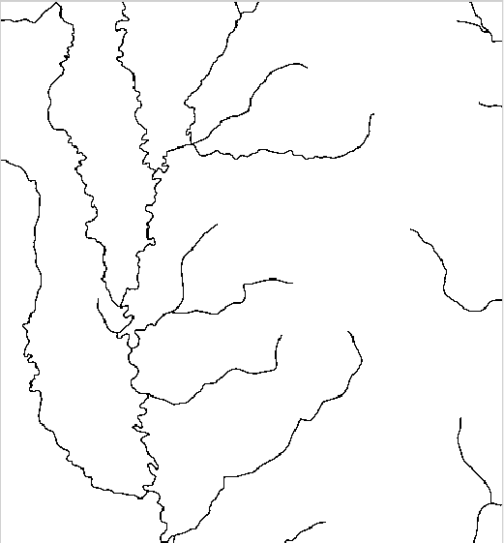
NHDPlus Rasters (cont.)
cat.tif
catseed.tif
elev_cm.tif
fac.tif
fdr.tif
fdroverland.tif
filldepth.tif
hydrodem.tif
shdrelief.jpg
swnet.tif
Notes:
​
Here are the NHDPlus HR Rasters. ​
The raster data includes raster catchment files, source elevation data(elev_cm.tif), shaded relief, flow direction grids and flow accumulation rasters. ​
​
​
While these are raster files you can see how some of them look like a stream network.​

Slide 8
NHDPlus v2
NHDPlus HR
vs.
Derived Product
Created using snapshot
source data:
Created using snapshot
source data:
1) NHD at the 1:24,000 scale
1) NHD at the 1:100,000 scale (Med. Res)
2) WBD using Hydrologic Units HU4 or HU8 scale
Contains vector and raster files
3) 10-meter 3DEP Elevation Data
2) WBD using Hydrologic Units HU4
3) 1-meter NED Elevation Data
Enhanced Stream Network
including:
- Value-added attributes (VAA’s)
Refresh cycle based on
source data updates
- Flow direction and accumulation grids
- Stream and catchment attributes
- Elevation-derived catchments
Partnership between EPA, USGS and Horizon Systems
Partnership between the USGS and Horizon Systems
Uses: Modeling, Navigation, and Analysis
Notes:
Now that you understand the data better let’s look at them side by side.
-The differences listed on each side are listed in a comparable order.
- I’ll start on the left. The NHD is source data where it is live, editable data again from many contributors.
The NHDPlus HR on the other hand is a derived product, meaning this could be outdated if the NHD, WBD or 3DEP data sources have change.
The NHDPlus HR is updated on a cycle based on source data updates.
-The NHD data contains only vectors where the NHDPlus HR contains both vector and raster files.
-Next, the partnerships are different for the two products.
As I have stated, the NHD is partnership between USGS and other stakeholders.
The NHDPlus HR is a partnership between USGS and Horizon Systems.
-Moving on to the next difference, the NHD is a component within the National Map. and therefore used for the USGS’ US Topo Maps as well as for other uses.
-On the other hand, the NHDPlus HR has the enhanced stream network navigation, analysis and data display as I previously mentioned providing more assistance for modeling.

Slide 9
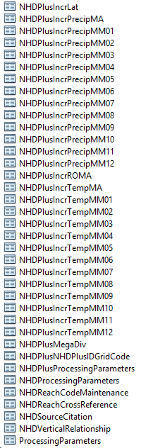
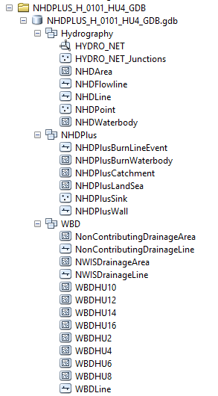
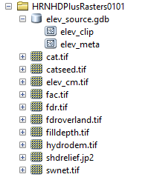
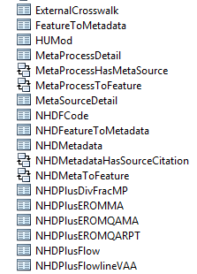
NHDPlus v2
NHDPlus HR
vs.
Vector data
Raster data
Notes:
Here you can see the files for both the NHD on the left and the NHDPlus HR on the right. You can also see the increase in quantity of information included within the NHDPlus HR.​
​
​
​

Slide 10
NHD
NHDPlus HR
vs.
Derived Product
Source Data
Created using snapshot
source data:
Live, editable data receiving continual updates
Surface Water Dataset
1) NHD at the 1:24,000 scale
2) WBD using Hydrologic Units HU4 or HU8 scale
3) 10-meter 3DEP Elevation Data
Contains only vectors
Refresh cycle based on
source data updates
Partnership between USGS and other stakeholders including federal, state, and other local entities.
Contains vector and raster files
Partnership between the USGS and Horizon Systems
Enhanced Stream Network
including:
- Value-added attributes (VAA’s)
Component of The National Map
Uses: Cartographic purposes, Application Ready (User must
perform analysis)
- Elevation-derived catchments
- Stream and catchment attributes
- Flow direction and accumulation grids
Uses: Modeling, Navigation, Analyses
Notes:
Now that you understand the data better let’s look at them side by side.
-The differences listed on each side are listed in a comparable order.
- I’ll start on the left. The NHD is source data where it is live, editable data again from many contributors.
The NHDPlus HR on the other hand is a derived product, meaning this could be outdated if the NHD, WBD or 3DEP data sources have change.
The NHDPlus HR is updated on a cycle based on source data updates.
-The NHD data contains only vectors where the NHDPlus HR contains both vector and raster files.
-Next, the partnerships are different for the two products.
As I have stated, the NHD is partnership between USGS and other stakeholders.
The NHDPlus HR is a partnership between USGS and Horizon Systems.
-Moving on to the next difference, the NHD is a component within the National Map. and therefore used for the USGS’ US Topo Maps as well as for other uses.
-On the other hand, the NHDPlus HR has the enhanced stream network navigation, analysis and data display as I previously mentioned providing more assistance for modeling.

Slide 11
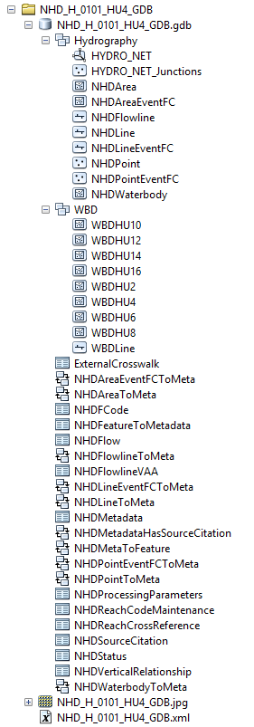
NHD
NHDPlus HR
vs.
Vector data
Raster data
Notes:
Here you can see the files for both the NHD on the left and the NHDPlus HR on the right. You can also see the increase in quantity of information included within the NHDPlus HR.​
​
​
​

Slide 12
NHD
NHDPlus HR
Both datasets:
Nationwide Coverage
Seamless Hydrographic Network
High Resolution 1:24K scale data
Named Features (GNIS)
Addressing Features
Ie. Reachcodes vs NHDPlusIDs
Notes:
Here you can see the similarities of the two products.
Both the NHD and the NHDPlus HR have a national hydrographic network with a 1:24 thousand scale.
They both include named features as well as have a method of addressing or finding features.
The NHD contains unique reachcode while the NHDPlus HR uses NHDPlusIDs.

Slide 13
NHD
NHDPlus HR
Derived Product
Source Data
Both datasets:
Created using snapshot
source data:
Live, editable data receiving continual updates
Surface Water Dataset
Nationwide Coverage
Seamless Hydrographic Network
High Resolution 1:24K scale data
Named Features (GNIS)
Addressing Features
Ie. Reachcodes vs NHDPlusIDs
1) NHD at the 1:24,000 scale
2) WBD using Hydrologic Units HU4 or HU8 scale
3) 10-meter 3DEP Elevation Data
Contains only vectors
Refresh cycle based on
source data updates
Partnership between USGS and other stakeholders including federal, state, and other local entities.
Contains vector and raster files
Partnership between the USGS and Horizon Systems
Enhanced Stream Network
including:
- Value-added attributes (VAA’s)
Component of The National Map
Uses: Cartographic purposes, Application Ready (User must
perform analysis)
- Elevation-derived catchments
- Stream and catchment attributes
- Flow direction and accumulation grids
Uses: Modeling, Navigation, Analyses
Notes:
By looking at the similarities and differences I hope you have a better understanding on which dataset will meet you needs.

Slide 14
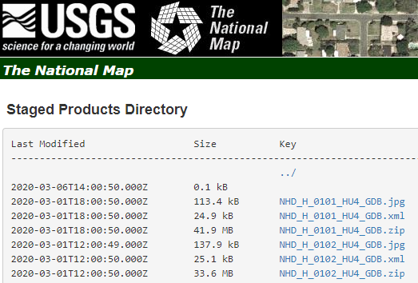
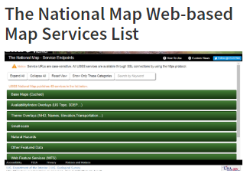
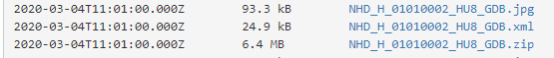
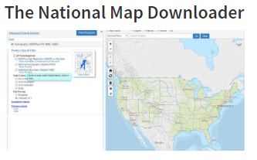
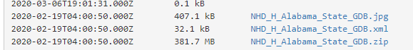
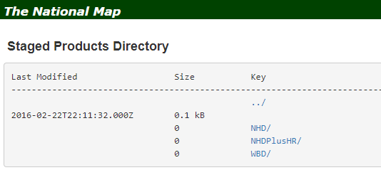
Where to find the NHD data?
usgs.gov/NHD/DataAccess​
Notes:
The NHD data can be found 4 ways:
1. The National Map Downloader
2. National Map Service
3. Download directly by link
With several extent options: National, State, HU4, or HU8, State
by 4-digit Hydrologic Unit (HU4) and 8-digit Hydrologic Unit (HU8) are refreshed monthly
by State are refreshed every two months
by Entire Nation are refreshed quarterly
4. You can also download directly from the cloud by going to the usgs.gov/NHD website

Slide 15

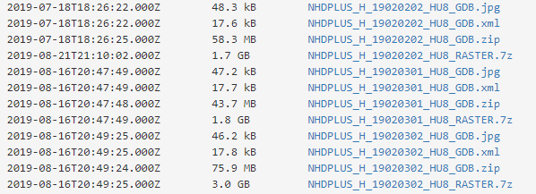
Where to find the NHDPlus HR data?
usgs.gov/NHD/DataAccess​​
Notes:
The NHDPlus HR data is available by through a direct link or cloud.
You will need to download both the NHDPlus HR vectors and rasters for a particular area.
The NHDPlus HR is available at the HU4 extents for CONUS and HU8’s in Alaska.

Slide 16
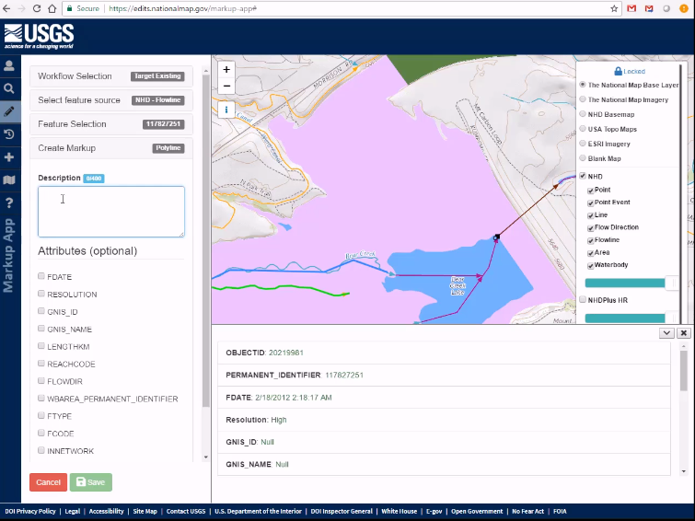
Reviewing and Updating Datasets
USGS’s Markup Application https://edits.nationalmap.gov/markup-app
              Collect suggestions for improvements to the NHD, WBD and NHDPlus HR
              Public, External Users, Internal USGS staff
NHD
Direct editing using the USGS’s NHDUpdate tool
  External Users
  Internal USGS staff
NHDPlus HR
Source datasets are updated and then NHDPlus HR will be reprocessed on a determined schedule.
Notes:
As you use the data and identify data improvements users can add them to the USGS’ Markup Application.
The Markup Application collect suggestions for the NHD, WBD, and NHDPlus HR. These suggestions can be added by the public, external and internal users. These suggestions are then reviewed and incorporated within the datasets.
The NHD can also be directed edited by data stewards.
Because the NHDPlus HR is a derived product edits should be provided through the Markup Application.

Slide 17
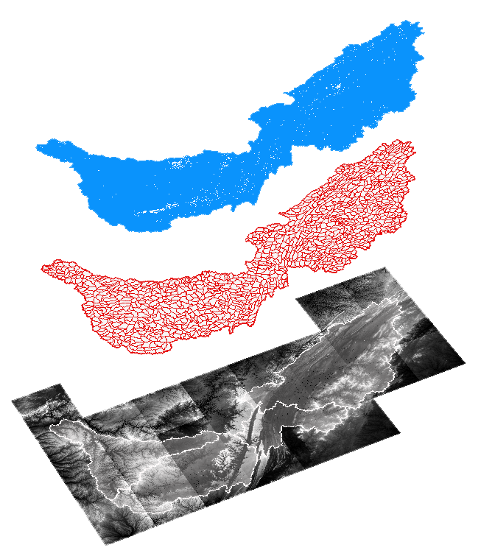
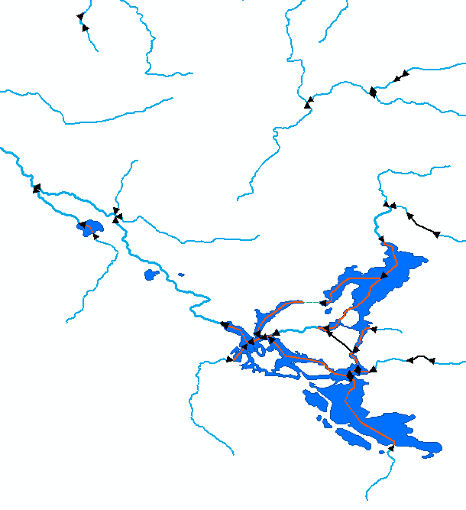
Questions
Support for NHD, WBD, & NHDPlus HR
National Geospatial Program (NGP)
Email: nhd@usgs.gov
Cynthia Ritmiller
critmiller@usgs.gov
Notes:
Thank you for attending today. I hope you have learned the more about the NHD and NHDPlus HR products.
Feel free to submit any questions to nhd@usgs.gov
Also if you would like to learn more about the NHDPlus HR data please attend the NHDPlus HR Workshop next Tuesday August 11th.

