Slide 1
The National Map
Your source for topographic information
LidarExplorer and TNM Downloader demo
MAGIP Local Government SIG Meeting
July 17, 2025
Elaine Guidero

Slide 2
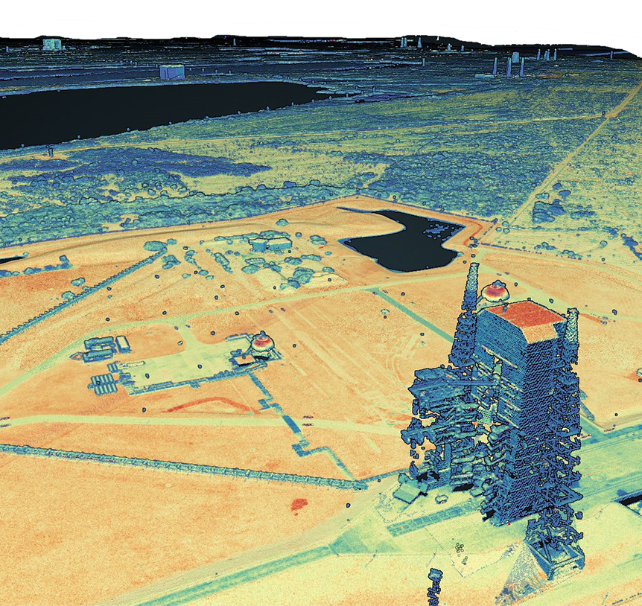
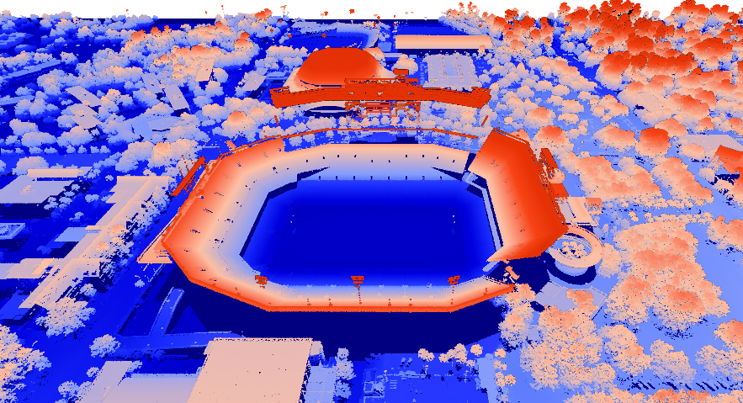
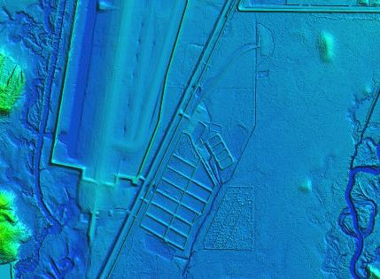
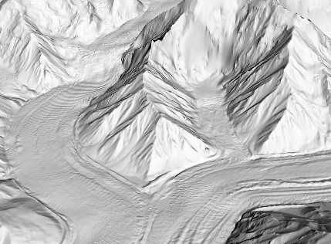
3DEP Products
Digital Elevation Models & Lidar Point Clouds
Ben Hill Griffin Stadium, FL Point Cloud
1-meter resolution DEM
5-meter resolution DEM (AK)
Cape Canaveral, FL Point Cloud

Slide 3
LidarExplorer
Click here
apps.nationalmap.gov/lidarexplorer
Notes:
LidarExplorer is the best way to find out where we have lidar, and direct links to the data, but also links to visualize the data in your browser, no download required.

Slide 4
LidarExplorer - show lidar index
Click here

Slide 5
LidarExplorer – define AOI
Click here

Slide 6
LidarExplorer – show DEM results
Click here

Slide 7
LidarExplorer – select DEM
Click here

Slide 8
LidarExplorer – download DEM
Click here

Slide 9
LidarExplorer – show LAZ results
Click here

Slide 10
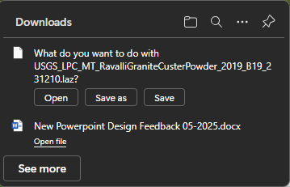
LidarExplorer – download LAZ tile

Slide 11
LidarExplorer – visualize

Slide 12
LidarExplorer – visualize

Slide 13
LidarExplorer – visualize

Slide 14
LidarExplorer – PDAL pipeline
Click here
Notes:
Click on Lidar Processing at the bottom of the search results to start creating files for a PDAL pipeline

Slide 15
LidarExplorer – PDAL pipeline
Click here

Slide 16
PDAL pipeline video
https://youtu.be/oHLgPAYzfy4
Notes:
Training video for how to use PDAL pipelines, on our TNM YouTube playlist, lesson 10h1

Slide 17
LidarExplorer – basic metadata & links
Click here

Slide 18
Rockyweb

Slide 19
TNM Downloader
apps.nationalmap.gov/tnmdownloader

Slide 20
TNM Downloader

Slide 21
TNM Downloader

Slide 22
TNM Downloader
Click here
Click here
Click here

Slide 23
TNM Downloader
Click here

Slide 24
TNM Downloader

Slide 25
TNM Downloader

Slide 26
Download uGet
https://sourceforge.net/projects/urlget

Slide 27
Unzip uGet & open “bin” folder
Notes:
If you can’t install anything, this is the best way to use uGet – and really, you don’t need to install it. You can just create a shortcut to the application on your desktop, and then use that anytime you want to run uGet.

Slide 28
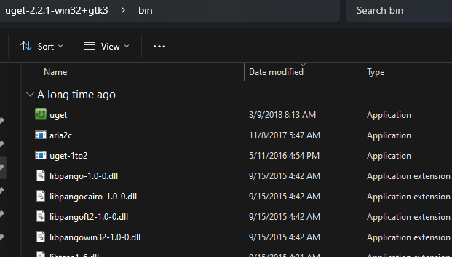
Double-click uget.exe
Notes:
This is the file to which you want to create a shortcut

Slide 29
uGet – open text file
Click here

Slide 30
uGet – click “Forward”
Click here

Slide 31
uGet – choose destination folder
Click here
Click here

Slide 32
uGet – watch the files roll in

Slide 33
Elaine Guidero
eguidero@usgs.gov

